Slide 1
Central bank digital currency in an open economy
Discussion by Frank Westermann

Slide 2
Summary
Extend the two-country DSGE model of Eichenbaum et al. (2017) by adding a new asset, CBDC
This new asset is issued in the home country to be used in the foreign country
A new uncovered interest parity condition:
  risk-free rate in the foreign economy=the interest rate on the CBDC adjusted for exchange rate risk + liquidity service parameters
CBDC amplifies the international spillovers of shocks
Intuition: stronger exchange rate movements, as foreign agents rebalance much more into CBDC than they would into bonds
Simulation + Welfare analysis
CBDC design + optimal monetary policy

Slide 3
  Definition of CBDC
Deposits not liquid? – CBDC short term, Deposits long term. Why?
Bonds not liquid? Very deep markets, as eligible collateral at central bank
Cash not International? (70% of the US$ and 30-40% of € used abroad)
Deposits not international? (FX markets trade > 5tr$ per day (BIS-Survey)).
Deposits not safe? (Deposit insurance + full allotment policy) H-Perspective

Slide 4
  New interest rate parity condition
Foreign interest rate = Interest rate on CBDC * Expected Exchange rate change * a Factor that measures the liquidity service of CBDC
households, for the same remuneration, strictly prefer to hold CBDC relative to a bond given that the CBDC provides liquidity services, unlike bonds
Their strong reaction to shocks amplifies the international spillovers

Slide 5
  DSGE model
+ fully modelled household optimization, labor markets etc.
+ Allows for welfare analysis! (example taxes)
- no closed form solution
- depends on parameter choices.
- liquidity service of CBCD 10% higher than Cash? Why not 100% or 1%?
? Wefare (Scale: Steady state consumption *10^4)

Slide 6
  Calibration vs. Simulation

Slide 7
  Technical features of CBDC
Households exchange bank deposits against CBDC at the price P(DC), which can be 1, or larger.
It can be (i) fixed interest rate (ii) flexible interest rate (iii) quantity based supply rule
Questions:
Why not in exchange for bonds? Or using bonds as collateral? (i.e. households are treated as „little banks“.)
There allready exits a very large Monetary base M0. Would a natural way be to convert reserves to CBDC?

Slide 8
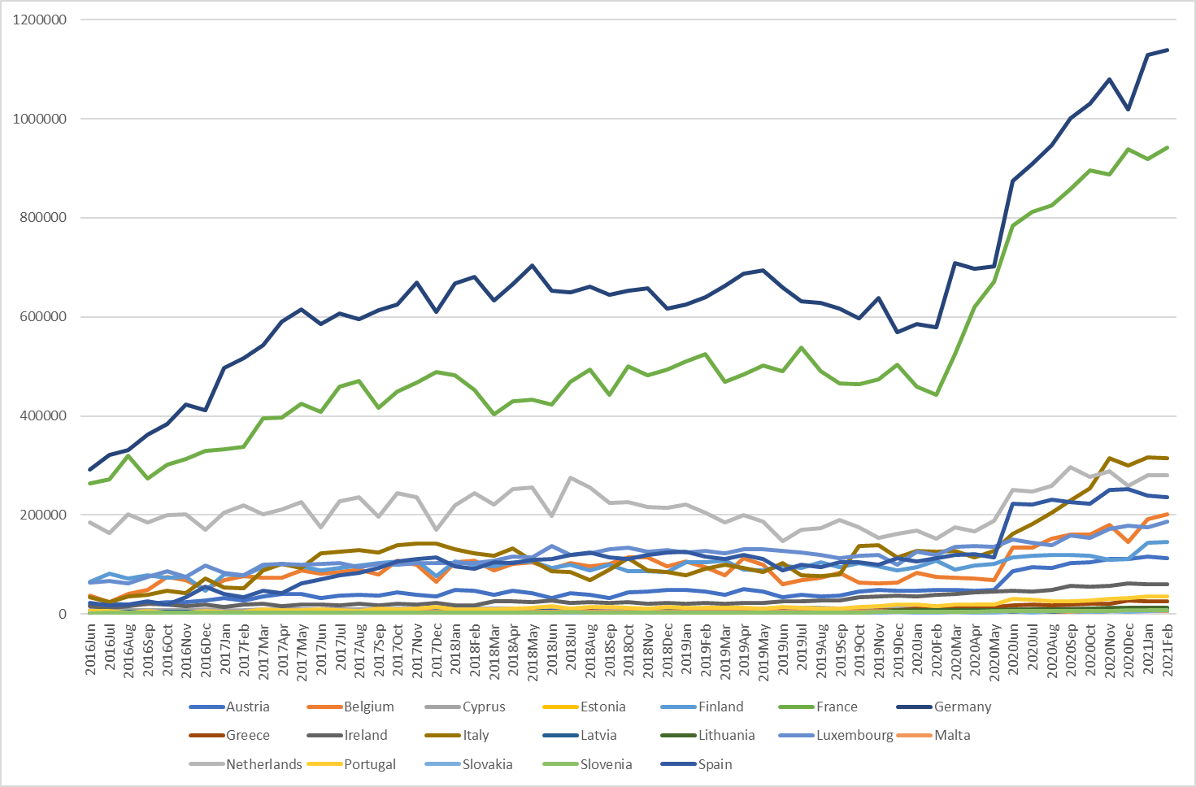
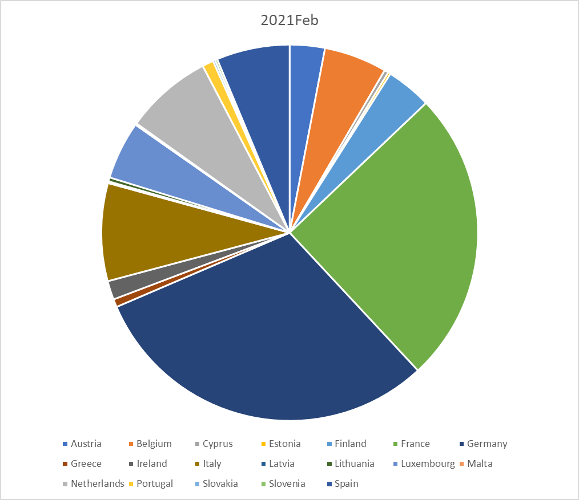
  Digital Currency vs. Reserve Deposits (Data from the ECB)

Slide 9
  Other questions
Monetary model vs. Portfolio balance model of the exchange rate? (assets are not perfect subsitutes)
Why look at the household problem, not an international representative investor? (…allocating his wealth on Bonds, Cash, Deposits, CBDC, home and foreign)
Why the asymmetry between countries? (first mover advantage vs. Steady state analysis)

Slide 10
Policy Implications
Conclusions in the paper
CBDC can amplify spillover and create challanges for (foreign)central banks
Following a taylor rule can mitigate these adverse effects
Other implications.
A key difference between CBDC and Cash is Storage cost – What is the effect of eliminating the 500€ bill – it increased storage cost.
Interest rate: Legal under current rules? (Fed needed to ask congress).
When all countries issue CBDC, is there a new form of currency wars?

Slide 11
  Summing up
Strength of the paper
  Important policy question
  Fully modelled household optimization problem
  Welfare statements are possible.
Critical points:
  Is CBDC really a “new asset”, or is the “new” aspect that standard features (liquidity) haven been taken away from other assets.
  „open economy“ is not very open (deposits, cash not international)
  Quantitative results depend on parameter choices; effects on welfare are unclear.
  By construction the model is limited to the „first mover advantage“; …as 80% of central banks are planing to introduce it.
  Hard to assess if welfare effects are quantitatively important.

