Slide 1
Comments on
Roger Vicquéry’s “The Rise and Fall of Global Currencies over Two Centuries”
Helen Popper
Santa Clara University
  Prepared for the May 3-4, 2021 Conference,
  Financial Globalization and De-Globalization

Slide 2
  Discussion Overview
The paper’s single equation
  ‘Control’ variables
  Orthogonalization
Data details

Slide 3
The paper’s single equation
  ‘Control’ variables
  Orthogonalization
  Data details

Slide 4
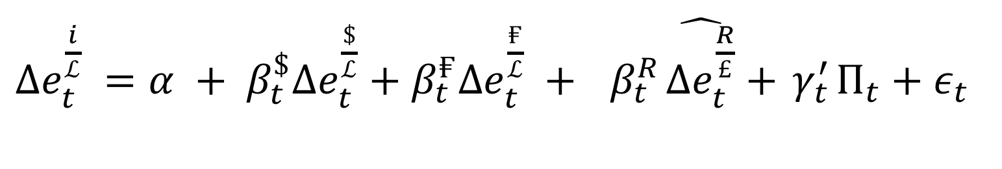
  The paper’s equation
$Δe_{t}^{\frac{i}{ℒ}} =α + β_{t}^{\$}Δe_{t}^{\frac{\$}{ℒ}}+β_{t}^{₣}Δe_{t}^{\frac{₣}{ℒ}} +{ β}_{t}^{R}\hat{Δe_{t}^{\frac{R}{£}}}+{ γ}_{t}^{′}Π_{t}+ε_{t}$

Slide 5
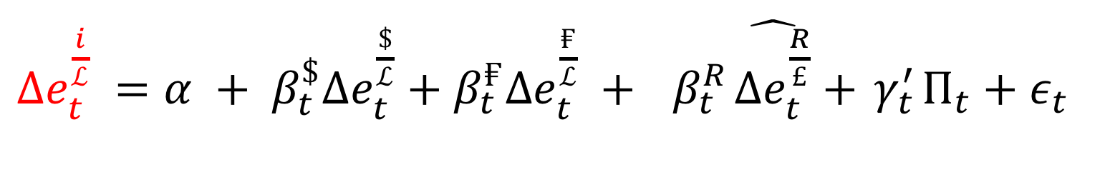
$Δe_{t}^{\frac{i}{ℒ}} =α + β_{t}^{\$}Δe_{t}^{\frac{\$}{ℒ}}+β_{t}^{₣}Δe_{t}^{\frac{₣}{ℒ}} +{ β}_{t}^{R}\hat{Δe_{t}^{\frac{R}{£}}}+{ γ}_{t}^{′}Π_{t}+ε_{t}$
Currency Depreciation

Slide 6
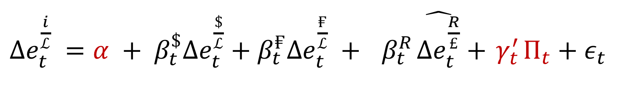
$Δe_{t}^{\frac{i}{ℒ}} =α + β_{t}^{\$}Δe_{t}^{\frac{\$}{ℒ}}+β_{t}^{₣}Δe_{t}^{\frac{₣}{ℒ}} +{ β}_{t}^{R}\hat{Δe_{t}^{\frac{R}{£}}}+{ γ}_{t}^{′}Π_{t}+ε_{t}$
Trend depreciation

Slide 7
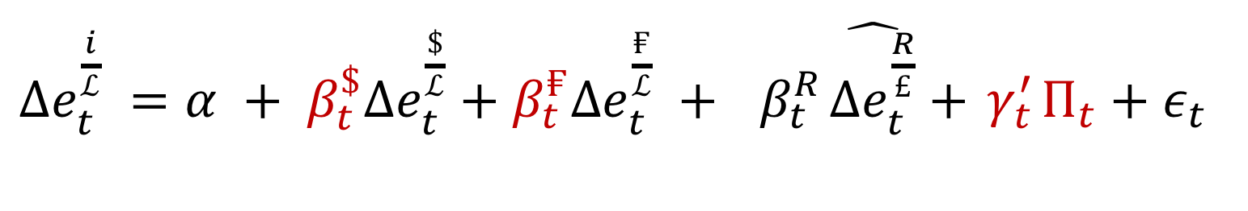
$Δe_{t}^{\frac{i}{ℒ}} =α + β_{t}^{\$}Δe_{t}^{\frac{\$}{ℒ}}+β_{t}^{₣}Δe_{t}^{\frac{₣}{ℒ}} +{ β}_{t}^{R}\hat{Δe_{t}^{\frac{R}{£}}}+{ γ}_{t}^{′}Π_{t}+ε_{t}$
Trend depreciation
Currency weights

Slide 8
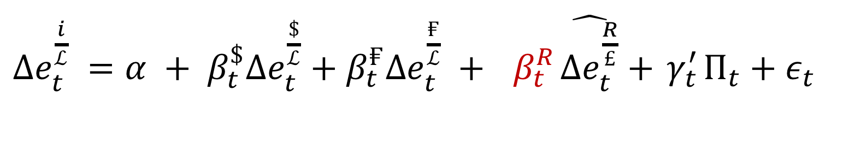
$Δe_{t}^{\frac{i}{ℒ}} =α + β_{t}^{\$}Δe_{t}^{\frac{\$}{ℒ}}+β_{t}^{₣}Δe_{t}^{\frac{₣}{ℒ}} +{ β}_{t}^{R}\hat{Δe_{t}^{\frac{R}{£}}}+{ γ}_{t}^{′}Π_{t}+ε_{t}$
Trend depreciation
Currency weights
Regional effect

Slide 9
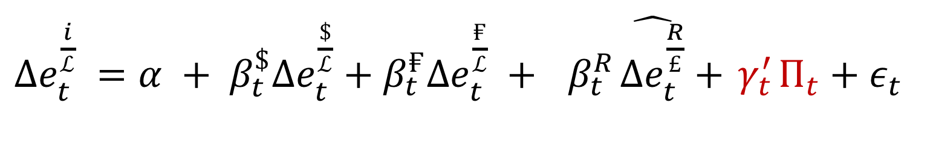
$Δe_{t}^{\frac{i}{ℒ}} =α + β_{t}^{\$}Δe_{t}^{\frac{\$}{ℒ}}+β_{t}^{₣}Δe_{t}^{\frac{₣}{ℒ}} +{ β}_{t}^{R}\hat{Δe_{t}^{\frac{R}{£}}}+{ γ}_{t}^{′}Π_{t}+ε_{t}$
Trend depreciation
Currency weights
Regional effect
‘Control’
variables

Slide 10
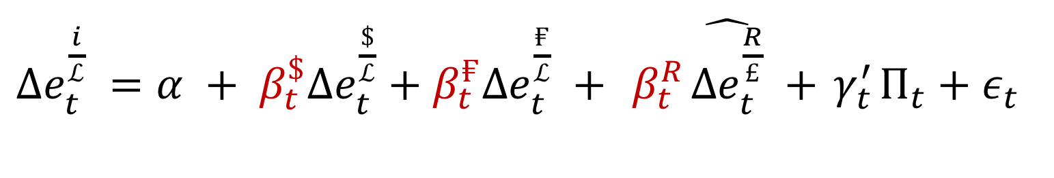
$Δe_{t}^{\frac{i}{ℒ}} =α + β_{t}^{\$}Δe_{t}^{\frac{\$}{ℒ}}+β_{t}^{₣}Δe_{t}^{\frac{₣}{ℒ}} +{ β}_{t}^{R}\hat{Δe_{t}^{\frac{R}{£}}} +{ γ}_{t}^{′}Π_{t}+ε_{t}$
An apportionment exercise

Slide 11
$Δe_{t}^{\frac{i}{ℒ}} =α + β_{t}^{\$}Δe_{t}^{\frac{\$}{ℒ}}+β_{t}^{₣}Δe_{t}^{\frac{₣}{ℒ}} +{ β}_{t}^{R}\hat{Δe_{t}^{\frac{R}{£}}} +{ γ}_{t}^{′}Π_{t}+ε_{t}$
An apportionment exercise
In good company:
Engel’s “Accounting for U.S. Real Exchange Rate Changes,”1999 JPE
Ito & McCauley “A key currency view of global imbalances” 2019 JIMF

Slide 12
The paper’s single equation
  ‘Control’ variables
  Orthogonalization
Data details
Notes:
Q2: modeling.
Pics: intuition

Slide 13
  Seminal work
Frankel & Wei, 1994
Notes:
Q2: modeling.
Pics: intuition

Slide 14
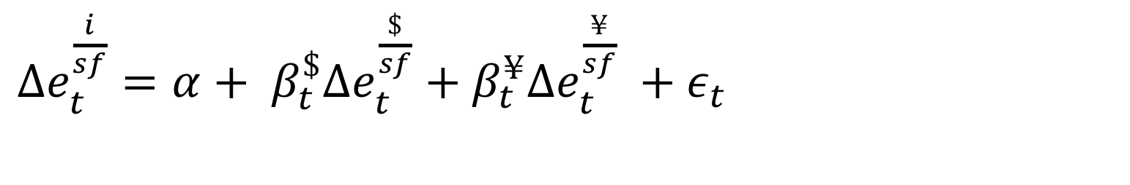
Frankel & Wei, 1994
$Δe_{t}^{\frac{i}{sf}}=α+ β_{t}^{\$}Δe_{t}^{\frac{\$}{sf}}+β_{t}^{¥}Δe_{t}^{\frac{¥}{sf}} +ε_{t}$
Notes:
Q2: modeling.
Pics: intuition

Slide 15
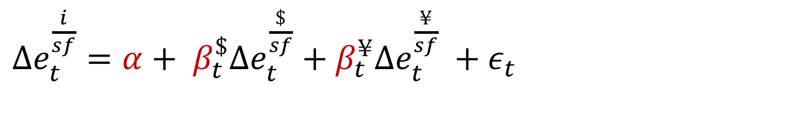
Frankel & Wei, 1994
$Δe_{t}^{\frac{i}{sf}}=α+ β_{t}^{\$}Δe_{t}^{\frac{\$}{sf}}+β_{t}^{¥}Δe_{t}^{\frac{¥}{sf}} +ε_{t}$
Trend depreciation
Currency weights
Notes:
Q2: modeling.
Pics: intuition

Slide 16
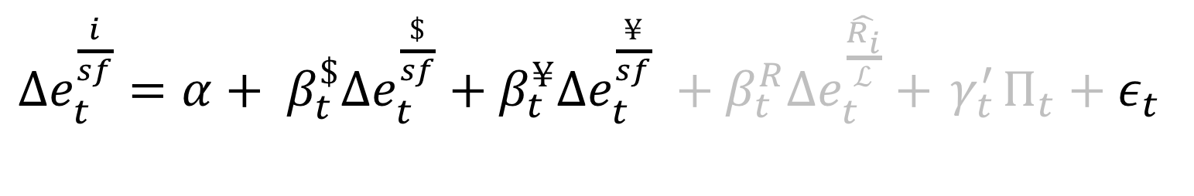
Frankel & Wei, 1994
$Δe_{t}^{\frac{i}{sf}}=α+ β_{t}^{\$}Δe_{t}^{\frac{\$}{sf}}+β_{t}^{¥}Δe_{t}^{\frac{¥}{sf}} +β_{t}^{R}Δe_{t}^{\hat{\frac{R_{i}}{ℒ}}}+{ γ}_{t}^{′}Π_{t}+ε_{t}$
Regional effect
‘Control’
variables
Notes:
Q2: modeling.
Pics: intuition

Slide 17
Frankel & Wei, 1994
Q: Why?
$Δe_{t}^{\frac{i}{sf}}=α+ β_{t}^{\$}Δe_{t}^{\frac{\$}{sf}}+β_{t}^{¥}Δe_{t}^{\frac{¥}{sf}} +β_{t}^{R}Δe_{t}^{\hat{\frac{R_{i}}{ℒ}}}+{ γ}_{t}^{′}Π_{t}+ε_{t}$
Regional effect
‘Control’
variables
Notes:
Q2: modeling.
Pics: intuition

Slide 18
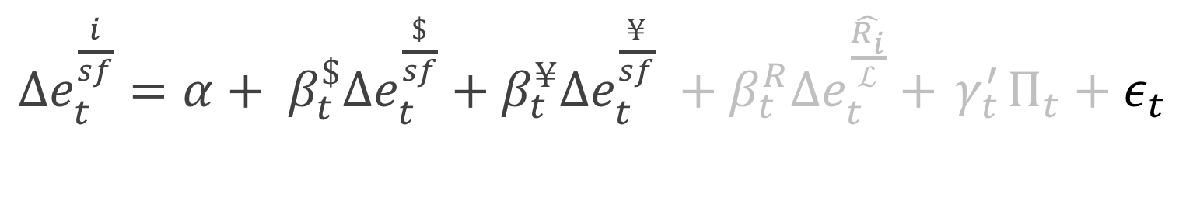
Frankel & Wei, 1994
Q: Why?
$Δe_{t}^{\frac{i}{sf}}=α+ β_{t}^{\$}Δe_{t}^{\frac{\$}{sf}}+β_{t}^{¥}Δe_{t}^{\frac{¥}{sf}} +β_{t}^{R}Δe_{t}^{\hat{\frac{R_{i}}{ℒ}}}+{ γ}_{t}^{′}Π_{t}+ε_{t}$
Regional effect
‘Control’
variables
  A: Including them would be overcontrolling.
Notes:
Q2: modeling.
Pics: intuition

Slide 19
  Example: potential ‘Control’ variable

Slide 20
  Example: potential ‘Control’ variable
How does a pandemic affect labor?
(Or leisure; take your pick.)
Notes:
Q2: modeling.
Pics: intuition

Slide 21
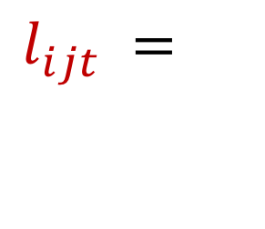

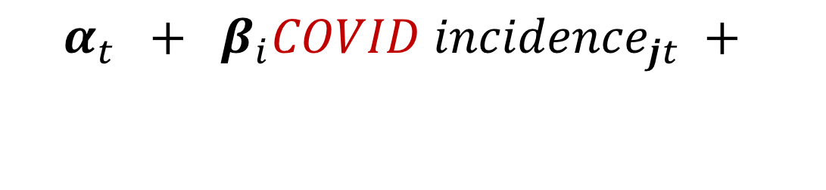
$$l_{ijt} =$$
$$α_{t} + β_{i}{COVID incidence}_{jt} +$$
$… +ε_{it}$
Notes:
Q2: modeling.
Pics: intuition

Slide 22
$$l_{ijt} =$$
$$α_{t} + β_{i}{COVID incidence}_{jt} +$$
$… +ε_{it}$
The variable of interest
Notes:
Q2: modeling.
Pics: intuition

Slide 23
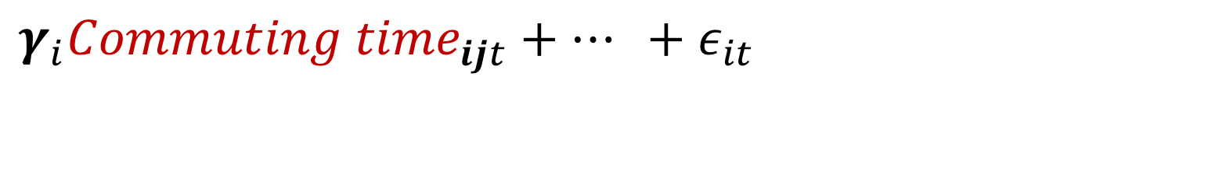
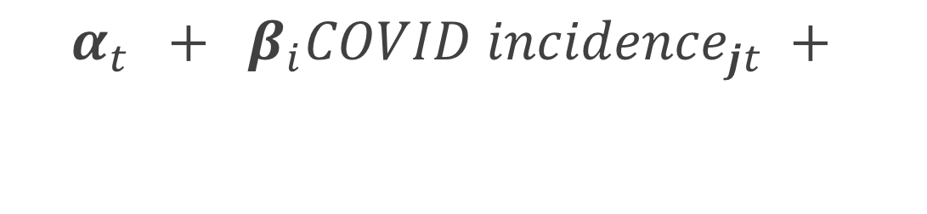
$$l_{ijt} =$$
$$α_{t} + β_{i}{COVID incidence}_{jt} +$$
$γ_{i}{Commuting time}_{ijt}+… +ε_{it}$
Add this ‘Control’ variable?
Notes:
Q2: modeling.
Pics: intuition

Slide 24
$$l_{ijt} =$$
$$α_{t} + β_{i}{COVID incidence}_{jt} +$$
$γ_{i}{Commuting time}_{ijt}+… +ε_{it}$
Add this ‘Control’ variable?
  (No, don’t.)
Notes:
Q2: modeling.
Pics: intuition

Slide 25
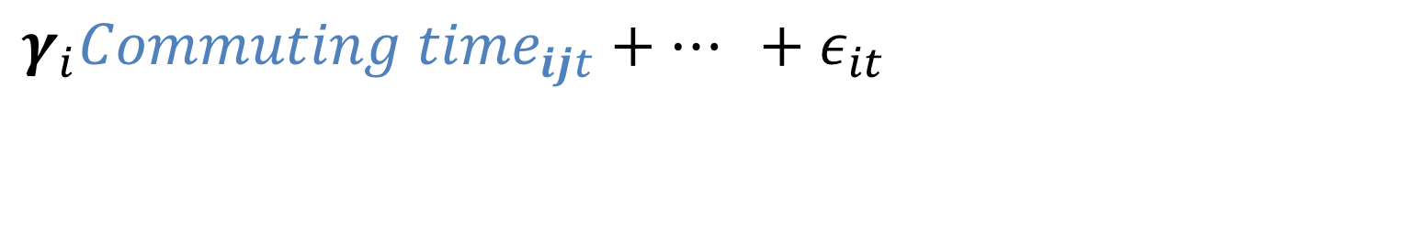
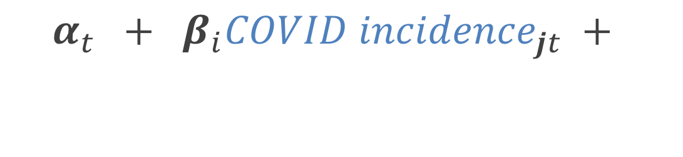
$$l_{ijt} =$$
$$α_{t} + β_{i}{COVID incidence}_{jt} +$$
$γ_{i}{Commuting time}_{ijt}+… +ε_{it}$
Notes:
Q2: modeling.
Pics: intuition

Slide 26
$$l_{ijt} =$$
$$α_{t} + β_{i}{COVID incidence}_{jt} +$$
$γ_{i}{Commuting time}_{ijt}+… +ε_{it}$
Notes:
Q2: modeling.
Pics: intuition

Slide 27
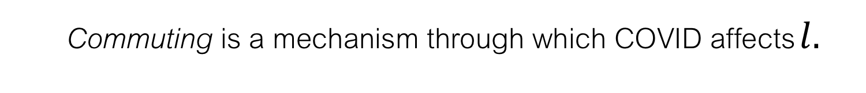
$$l_{ijt} =$$
$$α_{t} + β_{i}{COVID incidence}_{jt} +$$
$γ_{i}{Commuting time}_{ijt}+… +ε_{it}$
  Commuting is a mechanism through which COVID affects $l.$
Notes:
Q2: modeling.
Pics: intuition

Slide 28
$$l_{ijt} =$$
$$α_{t} + β_{i}{COVID incidence}_{jt} +$$
$γ_{i}{Commuting time}_{ijt}+… +ε_{it}$
  Commuting is a mechanism through which COVID affects $l.$
  (‘Commuting time’ resides in the causal pathway.)
Notes:
Q2: modeling.
Pics: intuition

Slide 29
$$l_{ijt} =$$
$$α_{t} + β_{i}{COVID incidence}_{jt} +$$
$γ_{i}{Commuting time}_{ijt}+… +ε_{it}$
  Including such a control variable inappropriately removes relevant variation from the variable of interest.
Notes:
Q2: modeling.
Pics: intuition

Slide 30

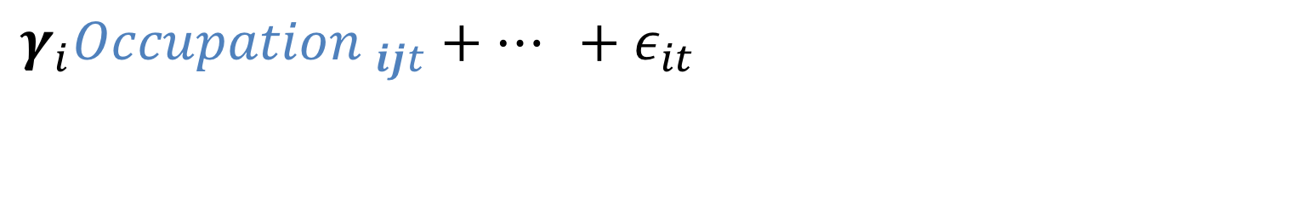
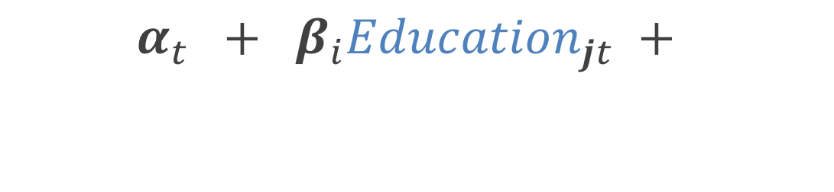
  Another Example: Mincer Equation
$$W_{ijt} =$$
$$α_{t} + β_{i}{Education}_{jt} +$$
$γ_{i}{Occupation }_{ijt}+… +ε_{it}$
  Including such a control variable inappropriately removes relevant variation from the variable of interest.
Notes:
Q2: modeling.
Pics: intuition

Slide 31

  This paper
$Δe_{t}^{\frac{i}{ℒ}} =α + β_{t}^{\$}Δe_{t}^{\frac{\$}{ℒ}}+β_{t}^{₣}Δe_{t}^{\frac{₣}{ℒ}} +{ β}_{t}^{R}\hat{Δe_{t}^{\frac{R}{£}}} +{ γ}_{t}^{′}Π_{t}+ε_{t}$
The apportionment exercise
Notes:
Q2: modeling.
Pics: intuition

Slide 32
  This paper
$Δe_{t}^{\frac{i}{ℒ}} =α + β_{t}^{\$}Δe_{t}^{\frac{\$}{ℒ}}+β_{t}^{₣}Δe_{t}^{\frac{₣}{ℒ}} +{ β}_{t}^{R}\hat{Δe_{t}^{\frac{R}{£}}} +{ γ}_{t}^{′}Π_{t}+ε_{t}$
Apportionment
  Including commodities & volatility proxies removes differentially relevant variation.
Notes:
Q2: modeling.
Pics: intuition

Slide 33
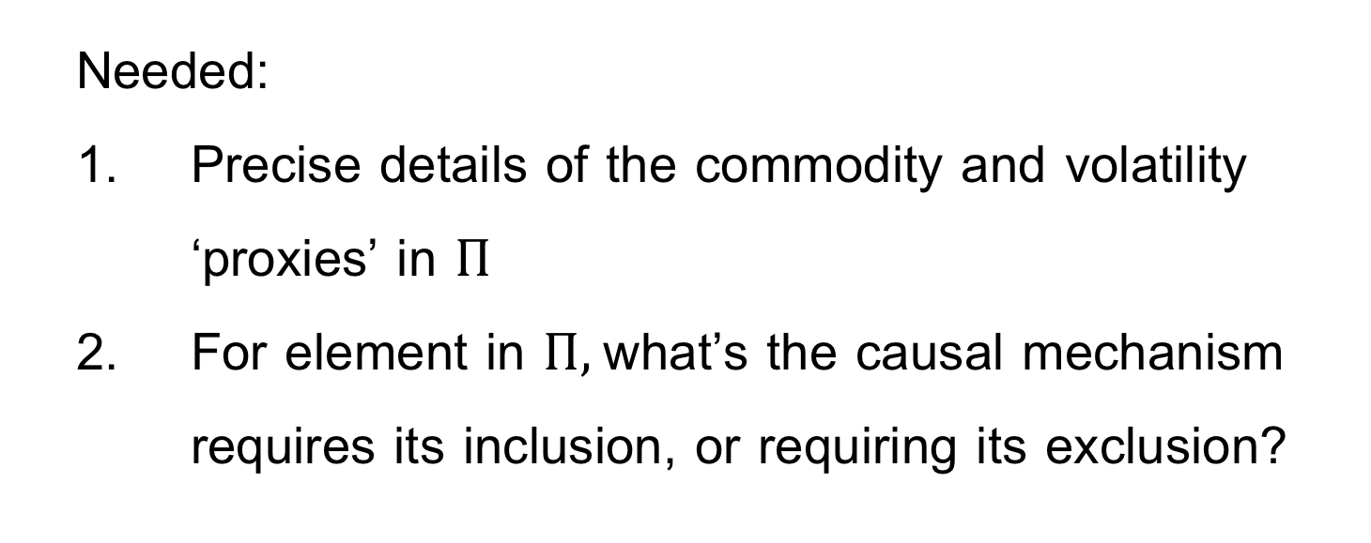
  This paper
  Needed:
  Precise details of the commodity and volatility ‘proxies’ in $Π$
  For element in $Π,$what’s the causal mechanism requires its inclusion, or requiring its exclusion?
Notes:
Q2: modeling.
Pics: intuition

Slide 34
  Key Related works
Ito & McCauley (2019, JIMF)
Follow Frankel & Wei (no controls); Commodity country status matters.
Mitchener & Pina (2020, JIMF)
Commodity prices drive pegs (and their demise)
Meissner & Oomes (2009, JIMF)
Anchors chosen to minimize volatility
Notes:
Q2: modeling.
Pics: intuition

Slide 35
The paper’s single equation
  ‘Control’ variables
  Orthogonalization
Data details
Notes:
Q2: modeling.
Pics: intuition

Slide 36
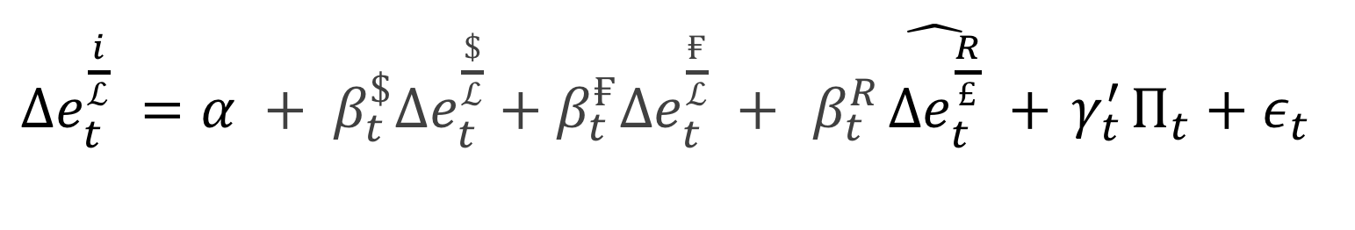
$Δe_{t}^{\frac{i}{ℒ}} =α + β_{t}^{\$}Δe_{t}^{\frac{\$}{ℒ}}+β_{t}^{₣}Δe_{t}^{\frac{₣}{ℒ}} +{ β}_{t}^{R}\hat{Δe_{t}^{\frac{R}{£}}} +{ γ}_{t}^{′}Π_{t}+ε_{t}$

Slide 37
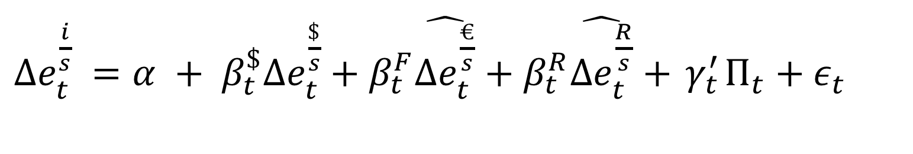
Cited Work: Fratzscher & Mehl, 2014 EJ
$Δe_{t}^{\frac{i}{s}} =α + β_{t}^{\$}Δe_{t}^{\frac{\$}{s}}+β_{t}^{F}\hat{Δe_{t}^{\frac{€}{s}}}+β_{t}^{R}\hat{Δe_{t}^{\frac{R}{s}}}+{ γ}_{t}^{′}Π_{t}+ε_{t}$

Slide 38
Fratzscher & Mehl, 2014 EJ
$Δe_{t}^{\frac{i}{s}} =α + β_{t}^{\$}Δe_{t}^{\frac{\$}{s}}+β_{t}^{F}\hat{Δe_{t}^{\frac{€}{s}}}+β_{t}^{R}\hat{Δe_{t}^{\frac{R}{s}}}+{ γ}_{t}^{′}Π_{t}+ε_{t}$
Currency weights
Regional effect
‘Control’
variables

Slide 39
Fratzscher & Mehl, 2014 EJ
$Δe_{t}^{\frac{i}{s}} =α + β_{t}^{\$}Δe_{t}^{\frac{\$}{s}}+β_{t}^{F}\hat{Δe_{t}^{\frac{€}{s}}}+β_{t}^{R}\hat{Δe_{t}^{\frac{R}{s}}}+{ γ}_{t}^{′}Π_{t}+ε_{t}$

Slide 40
Fratzscher & Mehl, 2014 EJ
$Δe_{t}^{\frac{i}{s}} =α + β_{t}^{\$}Δe_{t}^{\frac{\$}{s}}+β_{t}^{F}\hat{Δe_{t}^{\frac{€}{s}}}+β_{t}^{R}\hat{Δe_{t}^{\frac{R}{s}}}+{ γ}_{t}^{′}Π_{t}+ε_{t}$
Orthogonalized vis-à-vis the base currency

Slide 41
Fratzscher & Mehl, 2014 EJ
$Δe_{t}^{\frac{i}{s}} =α + β_{t}^{\$}Δe_{t}^{\frac{\$}{s}}+β_{t}^{F}\hat{Δe_{t}^{\frac{€}{s}}}+β_{t}^{R}\hat{Δe_{t}^{\frac{R}{s}}}+{ γ}_{t}^{′}Π_{t}+ε_{t}$
Orthogonalized vis-à-vis the base currency
Orthogonalized vis-à-vis both other currencies
Notes:
Q2: modeling.
Pics: intuition

Slide 42
Fratzscher & Mehl, 2014 EJ
$Δe_{t}^{\frac{i}{s}} =α + β_{t}^{\$}Δe_{t}^{\frac{\$}{s}}+β_{t}^{F}\hat{Δe_{t}^{\frac{€}{s}}}+β_{t}^{R}\hat{Δe_{t}^{\frac{R}{s}}}+{ γ}_{t}^{′}Π_{t}+ε_{t}$
Orthogonalized vis-à-vis the base currency
Orthogonalized vis-à-vis both other currencies
Why?
Notes:
Q2: modeling.
Pics: intuition

Slide 43
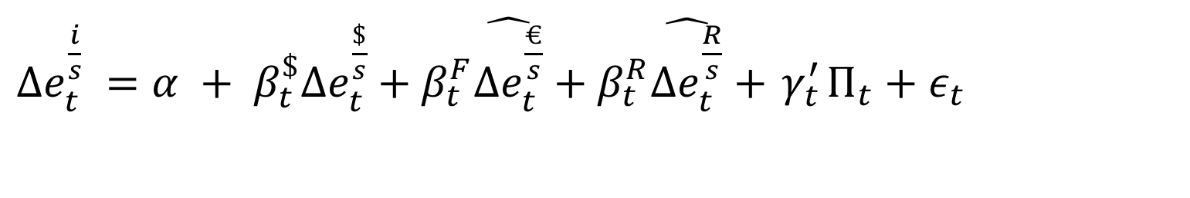
Fratzscher & Mehl, 2014 EJ
$Δe_{t}^{\frac{i}{s}} =α + β_{t}^{\$}Δe_{t}^{\frac{\$}{s}}+β_{t}^{F}\hat{Δe_{t}^{\frac{€}{s}}}+β_{t}^{R}\hat{Δe_{t}^{\frac{R}{s}}}+{ γ}_{t}^{′}Π_{t}+ε_{t}$
Regression sorts out the covariances.
Q: Why constrain the regression?
Notes:
Q2: modeling.
Pics: intuition

Slide 44
Fratzscher & Mehl, 2014 EJ
$Δe_{t}^{\frac{i}{s}} =α + β_{t}^{\$}Δe_{t}^{\frac{\$}{s}}+β_{t}^{F}\hat{Δe_{t}^{\frac{€}{s}}}+β_{t}^{R}\hat{Δe_{t}^{\frac{R}{s}}}+{ γ}_{t}^{′}Π_{t}+ε_{t}$
A: To provide an identification structure.
Notes:
Q2: modeling.
Pics: intuition

Slide 45
Fratzscher & Mehl, 2014 EJ
Orthogonalize for a specific reason:
Their objective: identify the unique role of the RMB
Their problem: the RMB comoves with the U.S. dollar.
Notes:
Q2: modeling.
Pics: intuition

Slide 46
Fratzscher & Mehl, 2014 EJ
Orthogonalize for a specific reason:
Their objective: identify the unique role of the RMB
Their problem: the RMB comoves extensively with the U.S. dollar in their sample period.
Notes:
Q2: modeling.
Pics: intuition

Slide 47
Fratzscher & Mehl, 2014 EJ
Their solution: orthogonalize to avoid the dollar effect.
They address the problem of severe multicollineary in the context of the specific purpose of their paper.
Notes:
Q2: modeling.
Pics: intuition

Slide 48
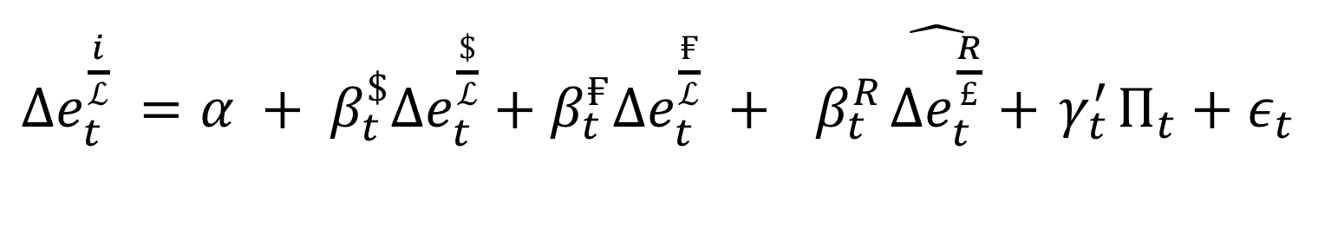
  This paper
$Δe_{t}^{\frac{i}{ℒ}} =α + β_{t}^{\$}Δe_{t}^{\frac{\$}{ℒ}}+β_{t}^{₣}Δe_{t}^{\frac{₣}{ℒ}} +{ β}_{t}^{R}\hat{Δe_{t}^{\frac{R}{£}}}+{ γ}_{t}^{′}Π_{t}+ε_{t}$
Notes:
Q2: modeling.
Pics: intuition

Slide 49
  This paper
$Δe_{t}^{\frac{i}{ℒ}} =α + β_{t}^{\$}Δe_{t}^{\frac{\$}{ℒ}}+β_{t}^{₣}Δe_{t}^{\frac{₣}{ℒ}} +{ β}_{t}^{R}\hat{Δe_{t}^{\frac{R}{£}}}+{ γ}_{t}^{′}Π_{t}+ε_{t}$
Q: Why handicap the regression?
the
Notes:
Q2: modeling.
Pics: intuition

Slide 50
  This paper
$Δe_{t}^{\frac{i}{ℒ}} =α + β_{t}^{\$}Δe_{t}^{\frac{\$}{ℒ}}+β_{t}^{₣}Δe_{t}^{\frac{₣}{ℒ}} +{ β}_{t}^{R}\hat{Δe_{t}^{\frac{R}{£}}}+{ γ}_{t}^{′}Π_{t}+ε_{t}$
(Q: And, why handicap it in this asymmetric way?)
the
Notes:
Q2: modeling.
Pics: intuition

Slide 51
Fratzscher & Mehl
Trying to isolate the specific effect
Orthogonalize for identification
This paper
Apportionment (accounting) is a horse race.
Orthogonalization unevenly handicaps the contenders.
(Aside: Gold
Recurring, leading role
If anything, perhaps orthogonalize vis-a-vis the gold exchange rate.)
Notes:
Q2: modeling.
Pics: intuition

Slide 52
Fratzscher & Mehl
Trying to isolate the specific effect
Orthogonalize for identification
This paper
Apportionment (accounting) is a horse race.
Orthogonalization unevenly handicaps the contenders.
(Aside: Gold
Recurring, leading role
If anything, perhaps orthogonalize vis-a-vis the gold exchange rate.)
Notes:
Q2: modeling.
Pics: intuition

Slide 53
The paper’s single equation
  ‘Control’ variables
  Orthogonalization
Data Details

Slide 54
  Data Details
  Biggest potential contribution: long series of historical data
  Usefulness depends on documenting reliability:
      Need: the nitty-gritty details.
      Compare with extensively used data compiled by other economic historians in overlapping periods.
      Decompose the novelty in your results into the part due to your methodological differences & the part due to different data.

Slide 55
  Conclusion
A potentially useful accounting exercise & ultimately a data source
  Long time span
  Work in progress
Suggestions going forward: Data and Methods
  Data—provide details & compare with other economic historians’ work.
  Methodology—Are the methods lifted from the literature appropriate? (E.g. conditioning, orthogonalization, numeraire, truncation,…)

