Slide 1
Comments on
What Types of Capital Flows Improve International Risk Sharing?
Remittances!
By Ergys Islamaj and M. Ayhan Kose
Menzie D. Chinn
University of Wisconsin, Madison & NBER
Conference on
Financial Globalization and De-Globalization:
Perspectives and Prospects
City Univ. of HK, USC, Osnabruck University
May 3-4, 2021

Slide 2
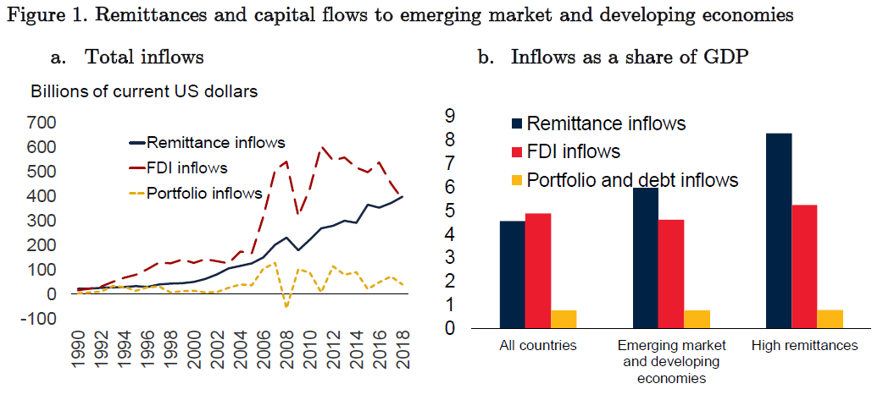
Big Flows

Slide 3
Main Findings
For a sample encompassing 79 Emerging Market/Developing Economies (EMDE’s), 1990-2018
Higher remittances are associated with better risk sharing (as measured by β between consumption and income growth)
No such comparable finding is found for other types of capital flows

Slide 4
Approach
Regress idiosyncratic consumption growth on idiosyncratic global growth
Under maintained hypothesis of perfect risk sharing, β=0

Slide 5
Approach
Regress idiosyncratic consumption growth on idiosyncratic global growth
Under maintained hypothesis of perfect risk sharing, β=0
Enhanced risk sharing effect if interactive term is negative

Slide 7
Diagnostics?

Slide 8
Remittances and Risk Sharing
Using the risk sharing estimate:
Implies:
“…about 15 percent of the achieved risk sharing in EMDEs can be attributed to remittances.”

Slide 9
A Joint Hypothesis
Perfect capital mobility across countries and zero transaction costs
Second, asset markets must be complete, so that all idiosyncratic consumption risks are insurable.
Third, in order for international trade in assets that bear claims on a country's domestic output to be feasible, output must be tradable.
So once one rejects composite null, point estimate is not necessarily reflective of degree of risk sharing

Slide 10
Maybe Not Such a Puzzle (with Hindsight)
Private financial capital flows uphill, due to…
Institutional underdevelopment and possible expropriation
Private flows procyclical due to asymmetric information causing herding, runs
Remittances are not as susceptible to these distortions (next slide)
- intra-household?
- harder to expropriate selectively?

Slide 11
Cyclicality

Slide 12
Conclusion
Clearly motivated, clearly organized
One of the few papers addressing remittances and risk sharing at the cross-country macro level
Robust findings on remittances contrast nicely with the near zero impact of capital flows
Establishes a new stylized fact
Looking forward - A panel analysis looking at how remittances comove (or don’t) with financial capital flows might be illuminating

