Slide 1
Fragmentation in the European Monetary Union: Is it really over?
Candelona, Luisia, Roccazzella
Comments by Paul De Grauwe

Slide 2
Main insights of this paper:
  ”Fragmentation risk”, i.e. speculative crises that lead to divergent movements in government bond yields in the Eurozone existed not only during the sovereign debt crisis of 2010-12
  but also before and after in particular during the covid pandemic of 2020.
  The Eurozone remains fragile

Slide 3
Let me first congratulate the authors for a fine and sophisticated analysis
However: There is a danger to applying ever more sophisticated statistical methods to analyse well-known phenomena.
Question arises whether this is always a good strategy
  Do we learn something we did not know already?
  What are we actually measuring?
I will look at these questions
Let’s first look at the government bond spreads.

Slide 4
10-year government bond spreads (relative to German Bund)

Slide 5
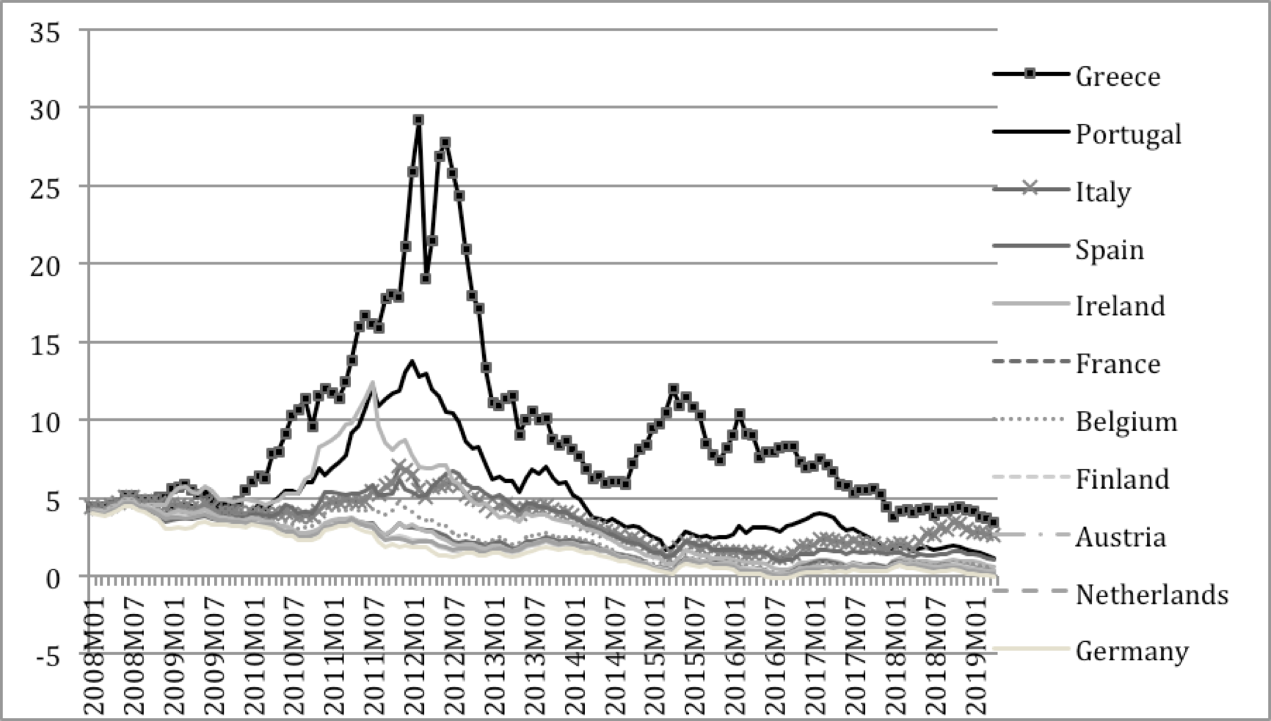
Figure 1.9 Ten-year government bond yields
Source: European Commission, AMECO databank

Slide 6
These spreads establish that during the sovereign debt crises there was a huge ”fragmentation risk”,
  a speculative crises erupted leading to massive flows out of the countries at risk towards those that were perceived as safe havens.
  During that period the yields became negatively correlated between risky countries and safe havens. (see next slide)

Slide 7
Table 2. Correlation of yields during crisis (2010M1-2012M09)

Slide 8
What about the period before?
Here I think the authors should have taken the whole period before, not just 2006-2009.
The latter period was dominated by the financial crisis of 2008-09
The divergence in yields starts with the financial crisis
If you take the whole period 2001-09 there is very little evidence of divergence in yields.
Correlations of yields is very highly positive.

Slide 9
Table 1. Correlation of yields before crisis (2000M1-2009M12)

Slide 10
Table 3. Correlation of yields after crisis (2012M10-2017M12)

Slide 11
What about the Covid period?
Yes there could be something here, but look at the spreads during that period:
There is a little surge in the spreads which however has declined
Maybe this is the beginning of something worse
My guess is that this is due to the fact that the second principal component gets all the attention in the measurement of the fragmentation risk.
When the influence of this second component is small it could be dominated by other factors (e.g. differences in liquidity)

Slide 12
Measurement without theory
What do the authors measure?
The statistical procedure measures bursts in divergence of yields.
We do not know what the cause of these divergences is.
Is it a solvency crisis: the sovereign is perceived of having accumulated unsustainable debt levels (the Greek case) and thus investors sell?
Is it a liquidity crisis: speculators fear that the sovereign may lack liquidity to rollover his debt (Spanish case)?
There is no way this statistical analysis answers these questions

Slide 13
Yet these are crucial questions as they determine the needed responses:
  Debt restructuring in the case of solvency crisis
  Lender of last resort by ECB in the case of liquidity crisis
In my previous research (with Yuemei Ji) published in JIMF I established that
  only in the case of Greece could one talk of a solvency crisis, i.e. driven by underlying fundamentals
  in the other countries hit by speculation it was better to talk about a self-fulfilling liquidity crisis wihtout any movements in fundamentals
The ECB responded to this with OMT.

Slide 14
Conclusion
There can be no doubt that the Eurozone remains fragile
And that large enough disturbances could lead to its unraveling
Yet the Covid pandemic has also shown the resilience of the system
Which is due to the fact that the ECB has reacted correctly with its PEPP programme
And the European Commission with its NextGenerationEU stimulus programme.

Slide 15
Table 1. Correlation of yields before crisis (2000M1-2009M12)
Table 2. Correlation of yields during crisis (2010M1-2012M09)
Table 3. Correlation of yields after crisis (2012M10-2017M12)

