Slide 1
Dynamic Interactions between Trade Globalization and Financial Globalization:
A Heterogeneous Panel VAR Approach
Soyoung Kim Seri Shim Donghyun Park
SNU SNU ADB

Slide 2
Backgrounds and Objectives
The postwar period has seen a rapid growth of both trade and financial globalization. However, the momentum of trade globalization slowed down after GFC. The Covid-19 likely accelerate post-GFC trade deglobalization trends further.
How will the ongoing trade deglobalization affect financial globalization?
More generally, the interactions between trade and financial integration

Slide 3
Past Studies
The effects of international trade integration on international financial integration
  Lane and Milesi-Ferretti (2003): trade integration promotes international financial integration. 1. trade involves corresponding financial transactions. 2. Obstfeld and Rogoff (2000), trade costs can generate home bias in asset trade. 3. trade openness motivates cross-border financial transactions by increasing familiarity or information.
  Forbes and Chinn (2004), Chambet and Gibson (2008), Anachotikul et al (2015) : yes , Vithessonthi and Kumarasinghe (2016): no
  Aizenman (2008): public finance channel: trade openness promotes financial reforms by increasing the effective cost of enforcing financial repression.
Relatively few studies on interactions between two types of integrations
  financial openness increase familiarity and information
  transaction costs in financial markets may affect transactions in trade
  Aizenman and Noy (2006, 2009), Aviat and Coeurdacier (2007)

Slide 4
This Study
investigates the interactions between two types of integration by employing structural panel VAR model with full heterogeneity across countries
Structural VAR
  consider interactions, identify exogenous shocks after controlling relevant variables, and examine “dynamic” effects.
“Panel” structure, “Full Heterogeneity” allowed
  Substantial heterogeneity across countries is found
  Try to draw a general conclusion on the relationship by fully exploiting the information from panel data but allowing full heterogeneity across countries.

Slide 5
Data
Following past studies such as Lane and Milesi-Ferretti (2003)
TRADE = (exports+imports)/GDP
FIN = (foreign assets+foreign liabilities)/GDP
Quarterly data: 1987:Q1-2019:Q4
38 countries + US
IFS, BOP/IPP, GEM, CEIC, national sources

Slide 6
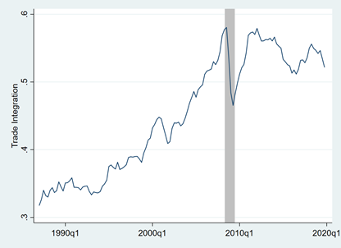
Figure 1. Trends in Global Trade Integration
Note: The weighted average of trade integration measure for sample countries. The shaded area indicates the Global Financial Crisis periods.

Slide 7
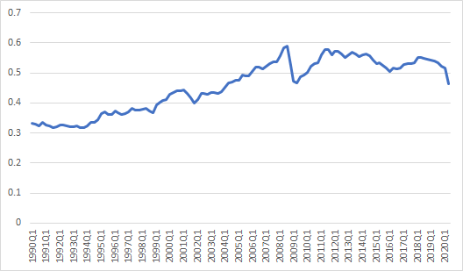
Extended to 2020Q2
dropped sharply at 2020:Q2

Slide 8
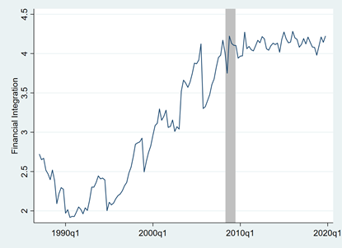
Figure 1. Trends in Global Financial Integration
Note: The weighted average of financial integration measure for sample countries. The shaded area indicates the Global Financial Crisis periods.

Slide 9
Table 1. Trade and Financial Integration
Note: The table lists the sample countries and reports the averages of trade and financial integration measures over the sample period for each country.

Slide 10
Granger-Causality Test
Unit root tests
  TRADE: The null hypothesis of unit root is rejected at 5% level in 29 out of 39 countries.
  FIN: The null hypothesis of unit root is rejected at 5% level in 20 out of 39 countries.
  Consider both level and first difference specifications for Granger-causality tests.
Granger-Causality Test
  The null hypothesis that TRADE does not Granger-cause FIN is rejected at 5 % level in 8 and 9 countries (for level and difference specifications, respectively).
  The null hypothesis of FIN does not Granger-cause TRADE is rejected at 5% level in 19 and 12 countries (for level and difference specifications, respectively).
  The results are mixed and vary across countries, showing a clear heterogeneity across countries in terms of the interactions between trade and financial integration.

Slide 11
Table 3. Granger-Causality Test
Note: ***,**,* indicate statistical significance at the 0.01, 0.05, 0.1 level, respectively.

Slide 12
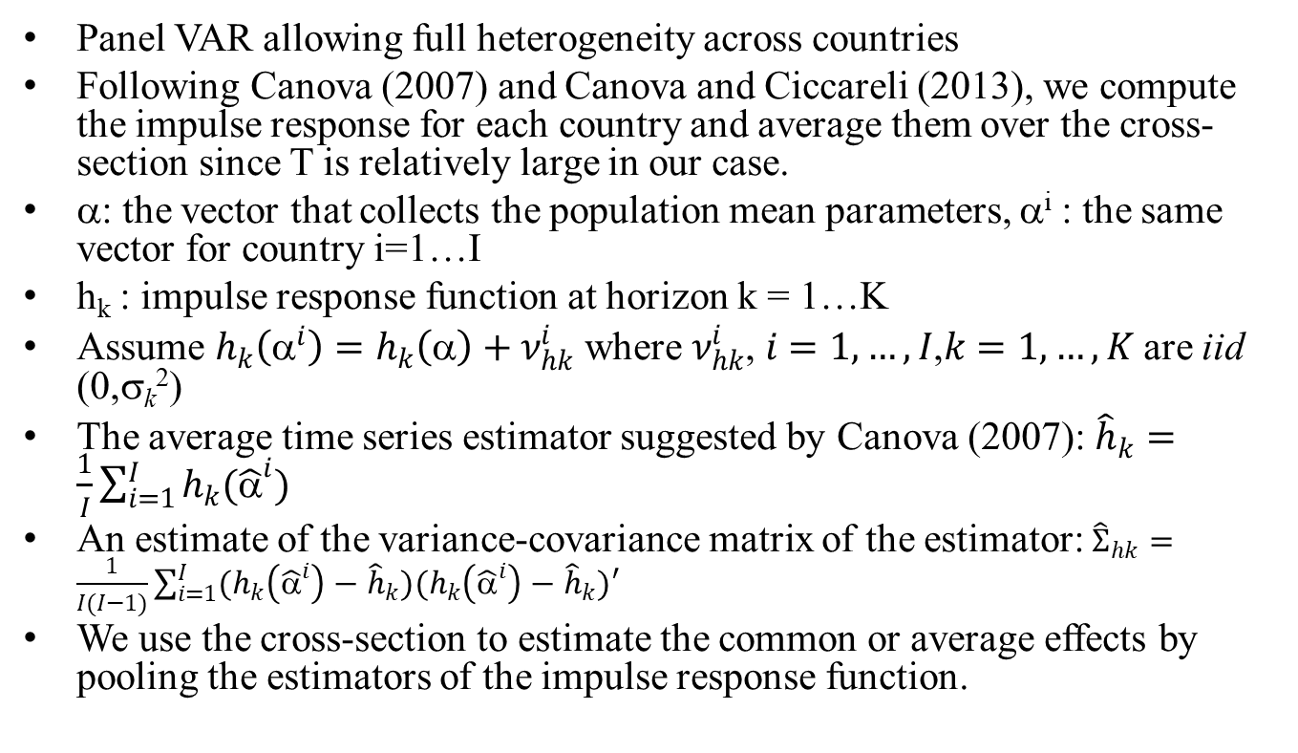
Heterogeneous Panel VAR
Panel VAR allowing full heterogeneity across countries
Following Canova (2007) and Canova and Ciccareli (2013), we compute the impulse response for each country and average them over the cross-section since T is relatively large in our case.
α: the vector that collects the population mean parameters, α^{i} : the same vector for country i=1…I
h_{k} : impulse response function at horizon k = 1…K
Assume $h_{k}\left(α^{i}\right)=h_{k}\left(α\right)+ν_{hk}^{i}$ where $ν_{hk}^{i}$, $i=1,…,I$,$k=1,…,K$ are iid (0,σ_{k}²)
The average time series estimator suggested by Canova (2007): ${\hat{h}}_{k}=\frac{1}{I}\sum_{i=1}^{I}{h_{k}({\hat{α}}^{i})}$
An estimate of the variance-covariance matrix of the estimator: ${\hat{Σ}}_{hk}=\frac{1}{I(I−1)}\sum_{i=1}^{I}{(h_{k}\left({\hat{α}}^{i}\right)−{\hat{h}}_{k})(h_{k}\left({\hat{α}}^{i}\right)−{\hat{h}}_{k})′}$
We use the cross-section to estimate the common or average effects by pooling the estimators of the impulse response function.

Slide 13
Empirical Model
2 Variable Model
  {TRADE, FIN}
  Recursive zero restrictions on contemporaneous structural parameters (Sims, 1980): TRADE is contemporaneously exogenous to FIN.
  based on the timing of the data construction: TRADE is flow data for a given quarter, FIN is the end of the period stock data.
  Exogenous variables: USRGDP, USFFR
  global financial crisis dummy (Q3 2008 – Q2 2009), four lags
6 Variable Model
  {RGDP, CPI, TRADE, R, ER, FIN}, R: policy interest rate, ER: exchange rate, exogenous variables: US real GDP, US FFR
  Macroeconomic condition and key financial variables likely affect trade and financial transactions.
  Identification 1. RGDP, CPI, TRADE → R, ER, FIN (data construction) 2: RGDP, CPI → TRADE, FIN (controlling macro variables) 3. R, ER → FIN (controlling financial variables)
  crisis dummy (Q3 2008 – Q2 2009), two lags, 28 countries only

Slide 14
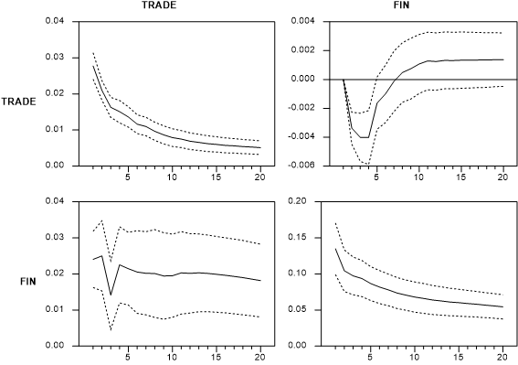
Figure 3. Impulse Responses: 2 Variable Model
TRADE shocks affect FIN positively and persistently.
FIN shocks affect TRADE negatively in the SR, not in the LR.

Slide 15
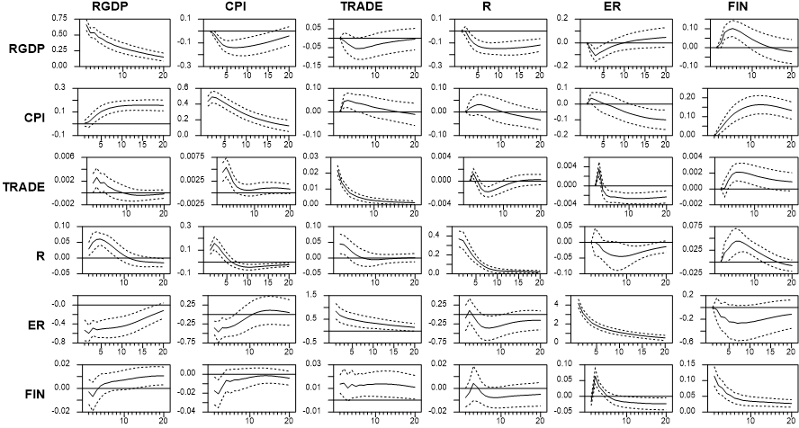
Figure 4. Impulse Responses: 6 Variable Model
After controlling various variables
TRADE shocks affect FIN positively and persistently.
FIN shocks affect TRADE positively.

Slide 16
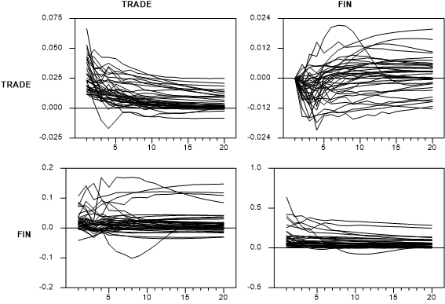
Figure 5. Impulse Responses: 2 Variable Model, Individual Countries
Huge heterogeneity in the results, especially for the effects of FIN shocks on TRADE.

Slide 17
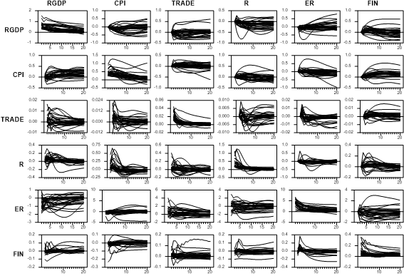
Figure 6. Impulse Responses: 6 Variable Model, Individual Countries
Huge heterogeneity in the results, especially for the effects of FIN shocks on TRADE

Slide 18
Extended Experiments I
Alternative Identifying Assumptions
(2 VAR) Assume that FIN is contemporaneously exogenous to TRADE. One period lagged values of FIN are used, so FIN at time t represents the value at the beginning of time t.
(6 VAR) Assume that R, ER, FIN are contemporaneously exogenous to RGDP, CPI, TRADE. One period lagged values of R, ER, FIN are used, so R, ER, FIN at time t represents the value at the beginning of time t.
The results are qualitatively similar.

Slide 19
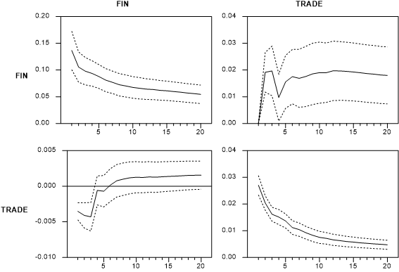
Figure 7. Impulse Responses: Alternative Identifying Assumption 1
Assume that FIN is contemporaneously exogenous to TRADE.
One period lagged values of FIN are used, so FIN at time t represents the value at the beginning of time t.

Slide 20
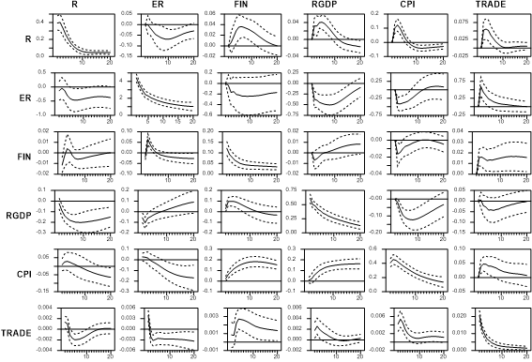
Figure 8. Impulse Responses: Alternative Identifying Assumption 2
Assume that R, ER, FIN are contemporaneously exogenous to RGDP, CPI, TRADE.
One period lagged values of R, ER, FIN are used, so R, ER, FIN at time t represents the value at the beginning of time t.

Slide 21
Extended Experiments II
Why is the result of 6 variable model different from that of 2 variable model?
  28 countries only in 6 variable model
  control variables?
4 lags in 6 variable model
The role of full heterogeneity: Panel VAR with individual fixed effect only

Slide 22
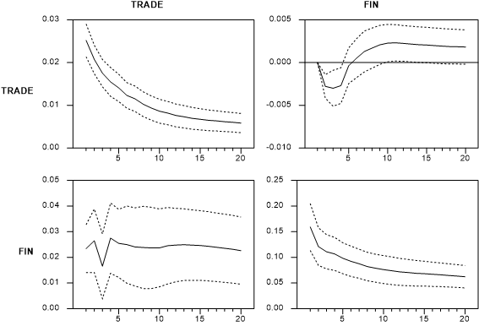
Figure 9. Impulse Responses: Reduced Sample
28 countries only as in 6 variable VAR. More positive responses of TRADE to FIN shocks are found but still weaker than those in the 6 variable model.
The positive effect of FIN shocks on TRADE found in the 6 variable model is not entirely due to reduced country sample.

Slide 23
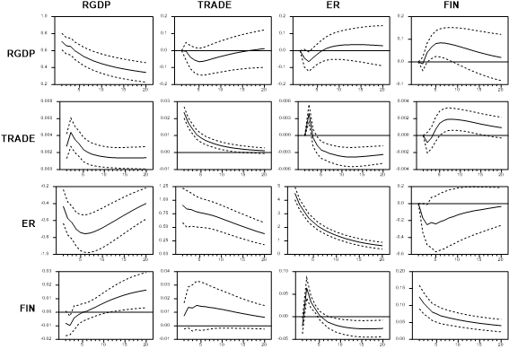
Figure 10. Impulse Responses: Combinations of Control Variables
We further explore which control variable contributes to the positive effect of FIN shocks on TRADE. We experiment with various combinations of the four control variables. We find that RGDP and ER are needed to obtain a significant increase in TRADE to FIN shocks

Slide 24
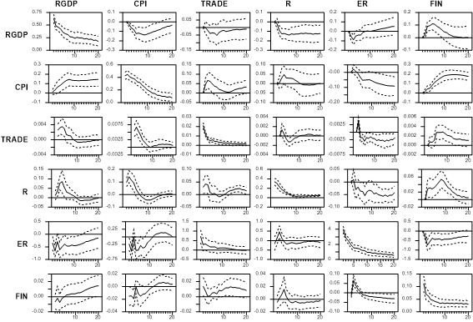
Figure 11. Impulse Responses: 6 Variable Model, 4 Lags
The results are qualitatively similar.

Slide 25
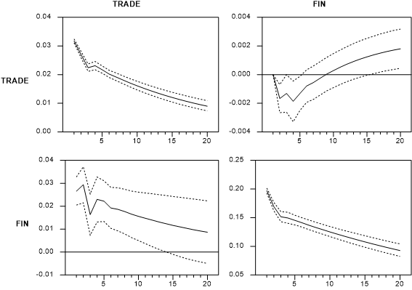
Figure 12. Impulse Responses: Panel VAR with Individual Fixed Effect
One important difference is the persistence of the effect. The positive effects of TRADE shocks on FIN in this model are less persistent than those in the baseline model. In addition, the positive effects of FIN shocks on TRADE in this model are more persistent than those in the baseline model. This suggests that the persistence of the effects can be misleading if we do not properly account for cross-country heterogeneity.

Slide 26
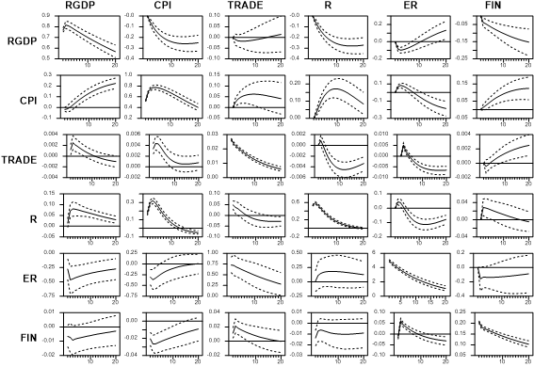
Figure 13. Impulse Responses: Panel VAR with Individual Fixed Effect

Slide 27
Conclusion
Investigate the dynamic relations between trade and financial integration using the heterogeneous panel VAR approach.
  draw a general conclusion on the issue by fully exploiting the information from panel data but allowing full heterogeneity across countries.
Trade integration has a positive and persistent effects on financial integration, which is very robust. Financial integration has a positive effect on trade integration when control variables are included.
If the Covid-19 shock accelerates trade deglobalization, this will affect financial globalization adversely.
However, the world may not necessarily experience financial deglobalization.
  Financial globalization can be accelerated with the help of FinTech and information technology developments, which have been highly favored during the Covid-19.
  The ongoing financial opening up and liberalization of China, the world’s second-biggest economy, can be a significant driver of financial globalization.

