Slide 1
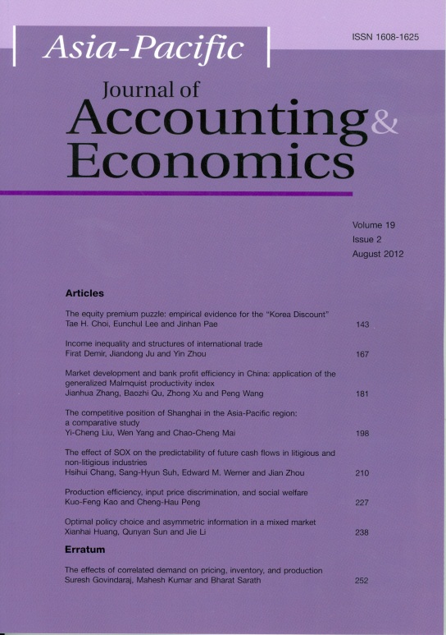
The 2011 APJAE Symposium on Dynamic System and World Trade
May 11-13, 2011
College Studio, College of Business,
City University of Hong Kong

Slide 2
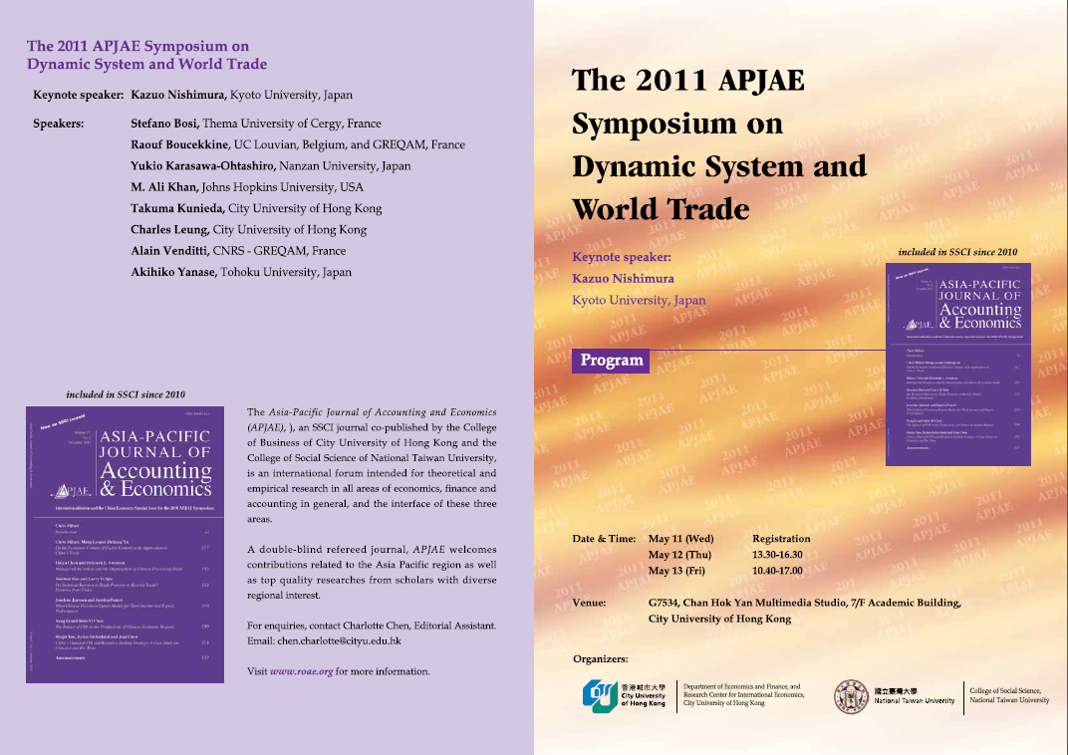
program

Slide 3
program

Slide 4
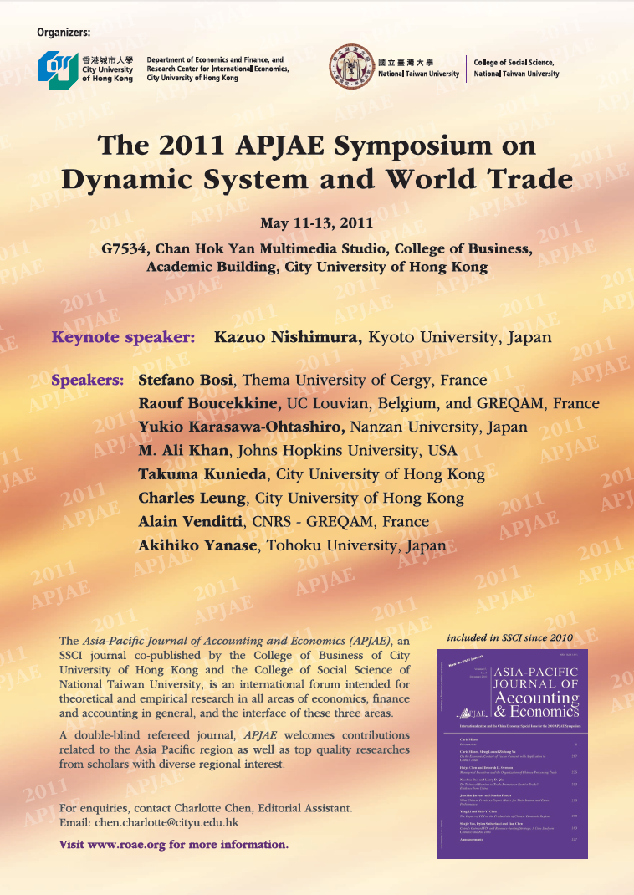
poster

Slide 5
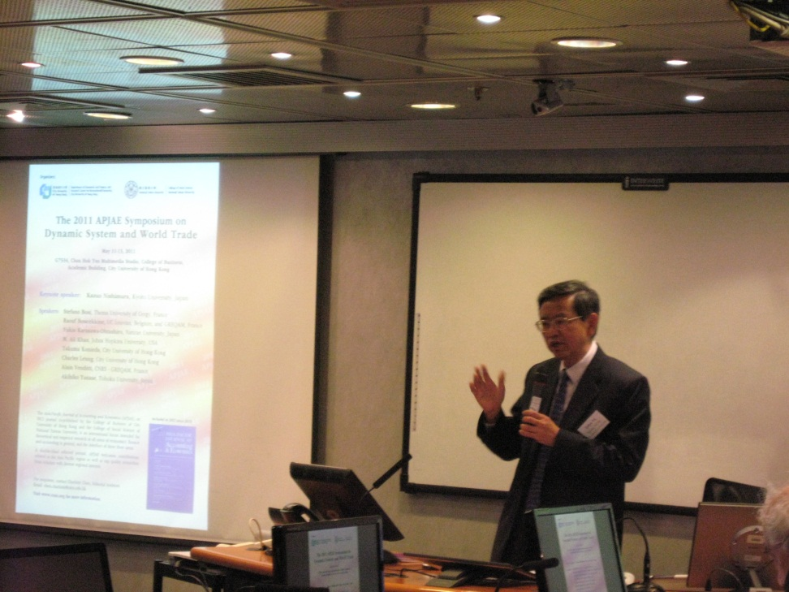
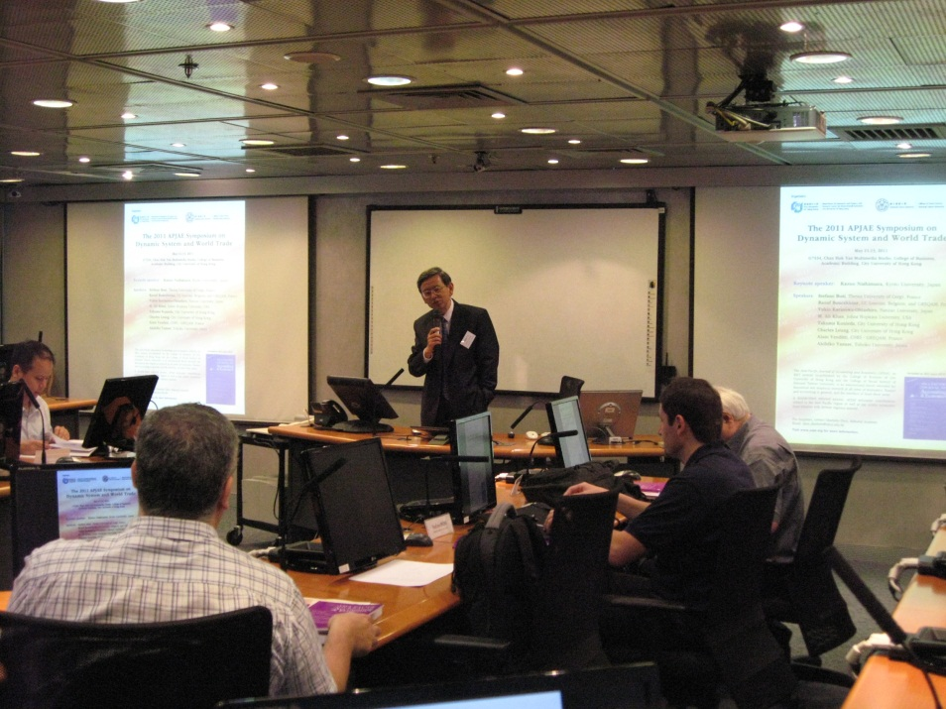
Welcoming remarks by Eden Yu of City University of Hong Kong, Editor of APJAE

Slide 6
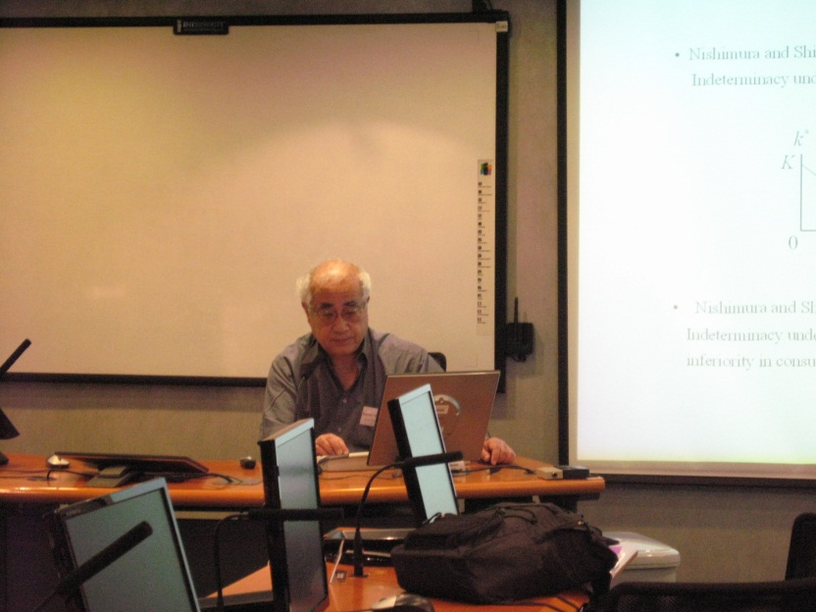
Kazuo nishimura of kyoto University, Japan presents his paper, “a dynamic heckscher-ohlin model and inferior goods”.

Slide 7
Raouf boucekkine of uc louvian, belgium, and greqam, france presents his paper, “on the optimal population size problem”.

Slide 8
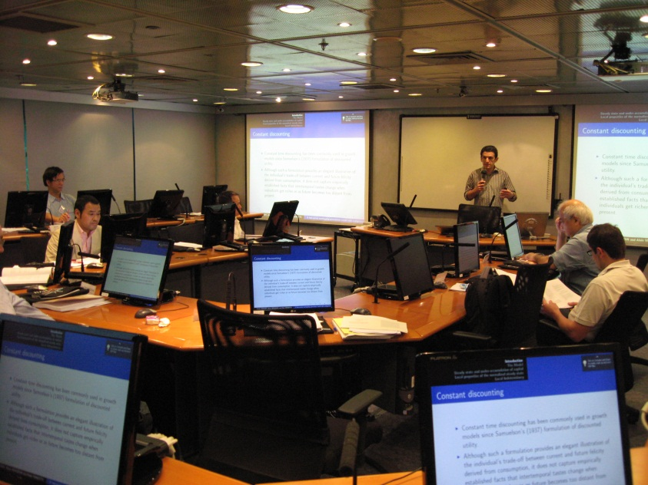
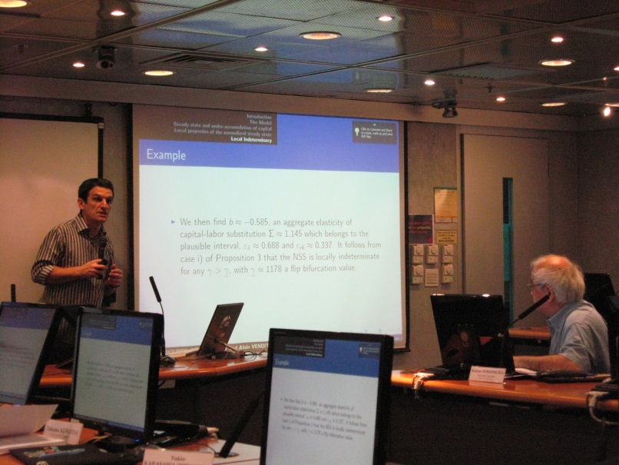
Alain Venditti of CNRS-GREQAM, France presents his paper, “A Two-sector Overlapping Generations Model with Endogenous Discounting”.

Slide 9
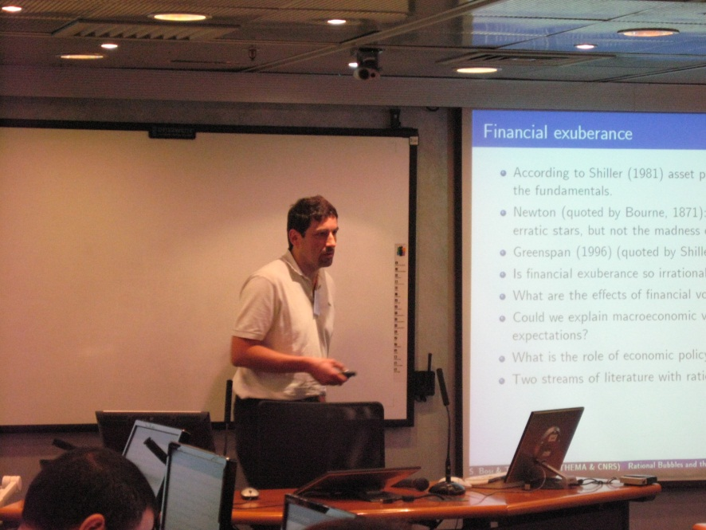
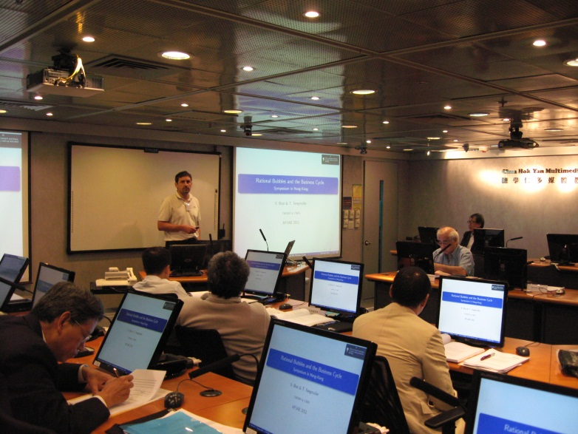
Stefano Bosi of Thema University of Cergy, France presents his paper, “On Rational Exuberance”.

Slide 10
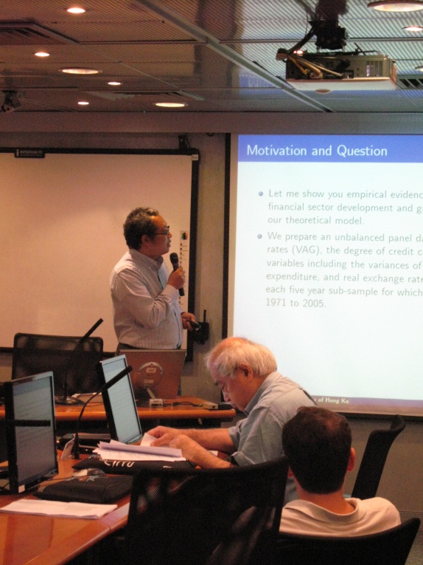
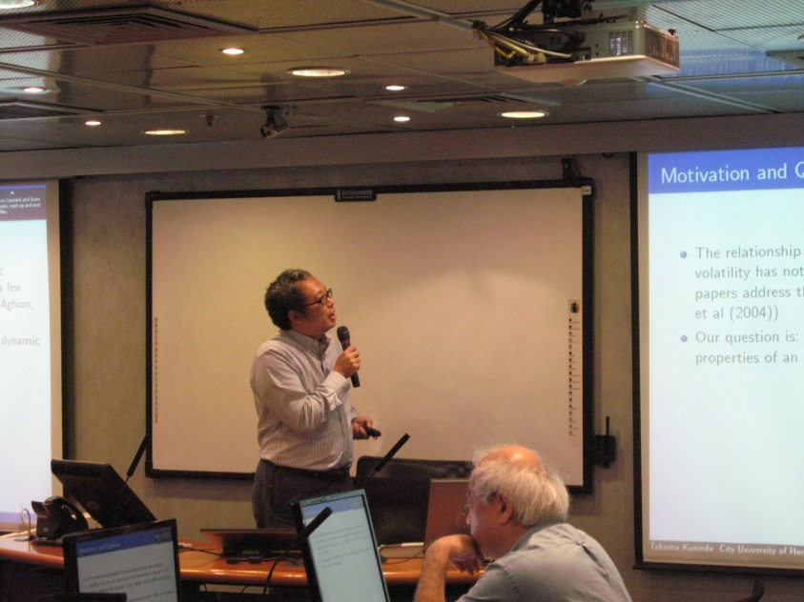
Takuma Kunieda of City University of Hong Kong presents his paper, “Business Fluctuations and Credit Market Imperfections”.

Slide 11
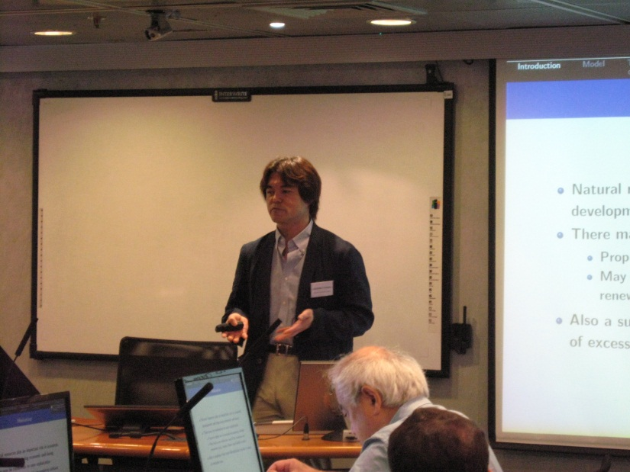
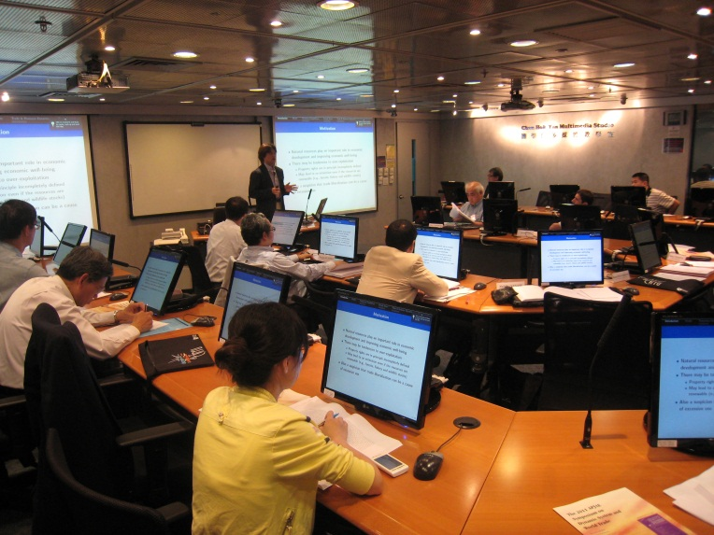
Akihiko Yanase of Tohoku University, Japan presents his paper, “Open-Access Renewable Resources as Inputs and International Trade: A Small Open Economy”.

Slide 12
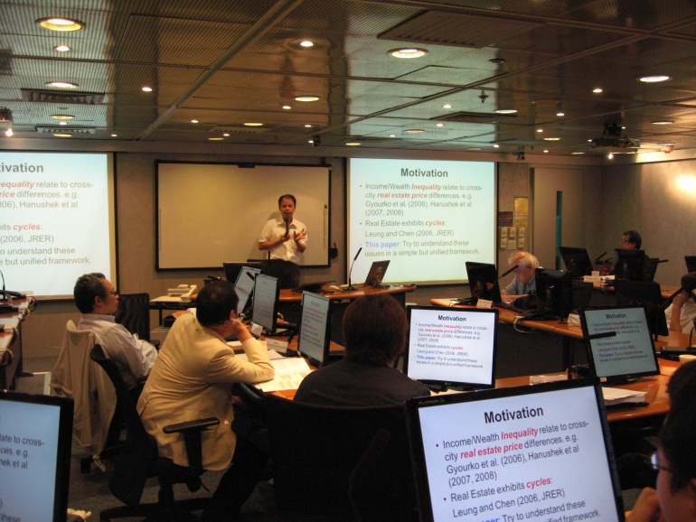
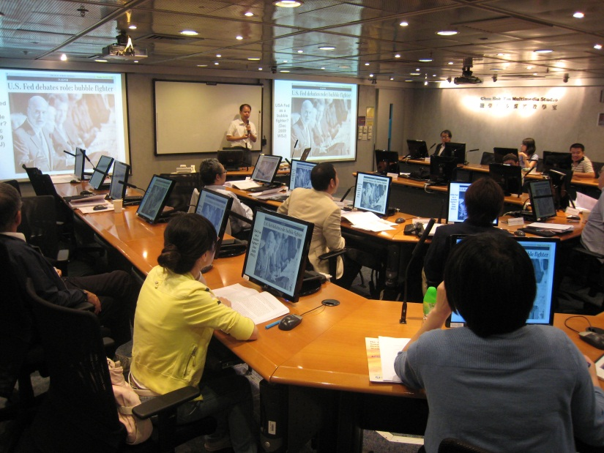
Charles Leung of City University of Hong Kong presents his paper, “Inequality Dynamics and Land Price Cycles”.

Slide 13
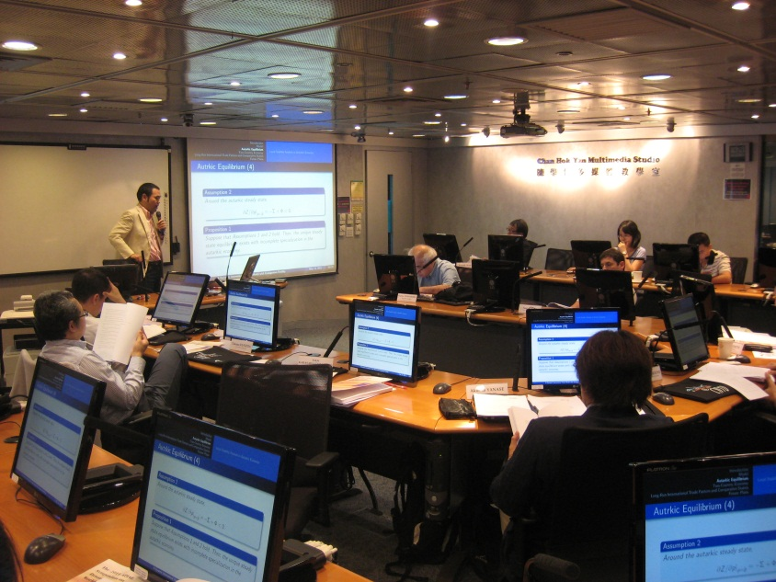
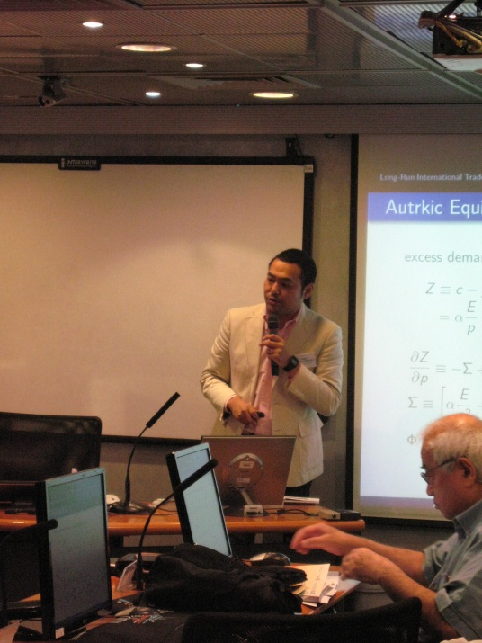
Yukio Karasawa-Ohtashiro of Nanzan University, Japan presents his paper, “A Dynamic International Trade Model with Endogenous Fertility”.

Slide 14
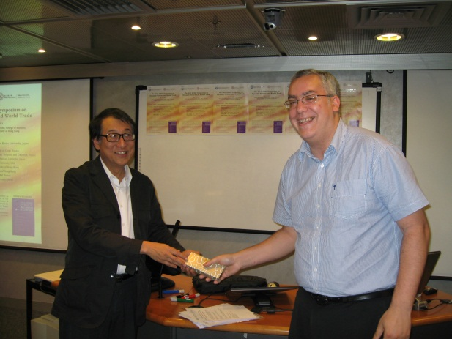
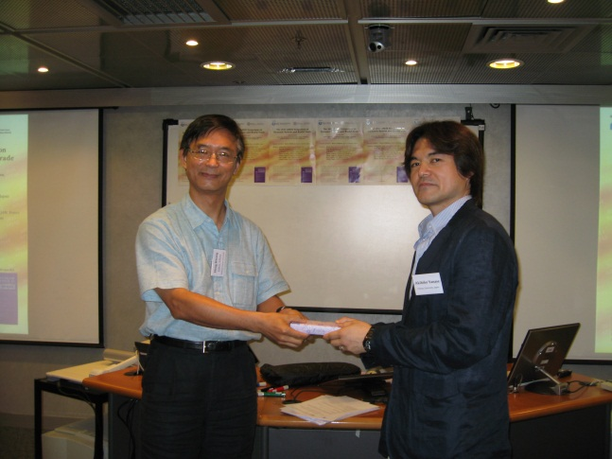
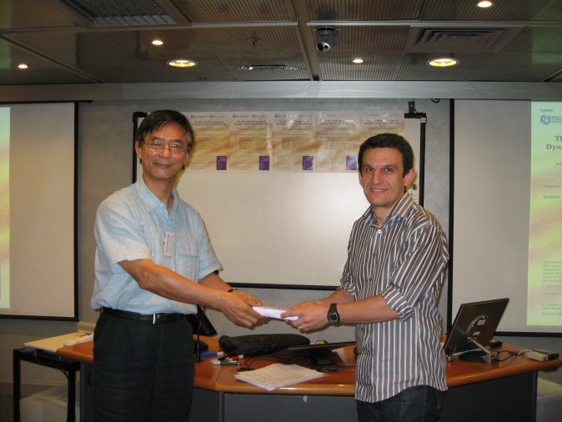
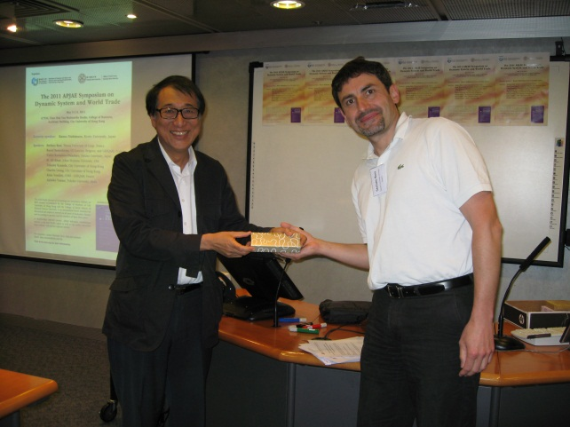
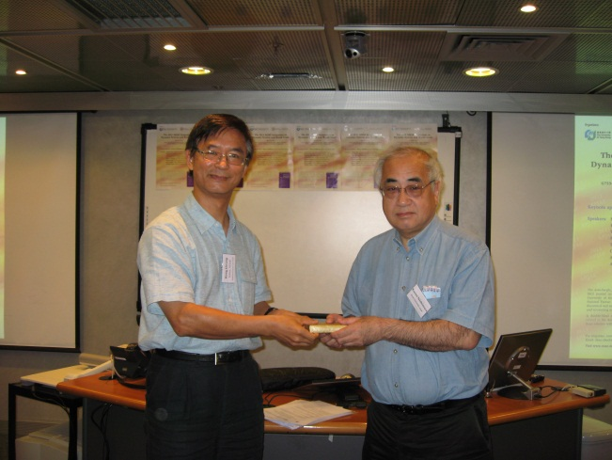
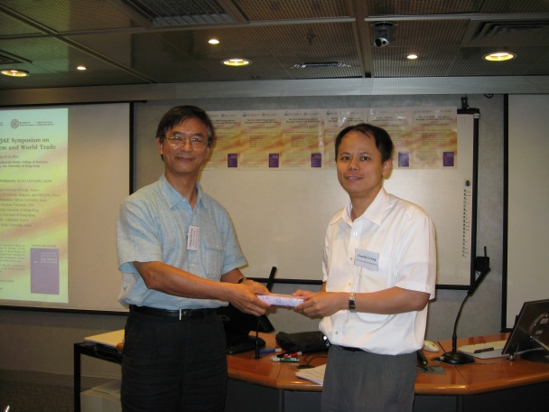
Souvenir presentation

Slide 15
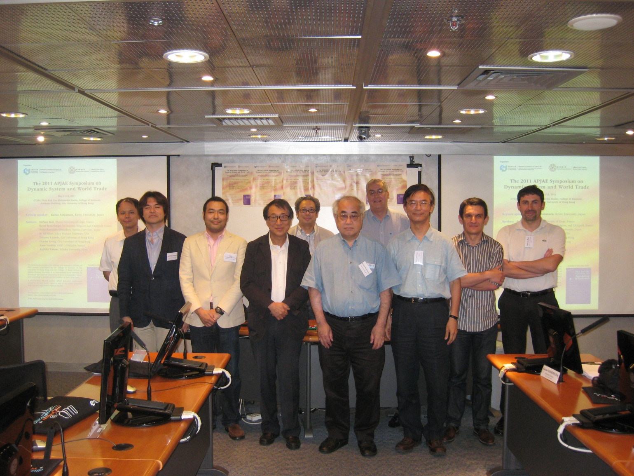
Group Photo

Slide 16
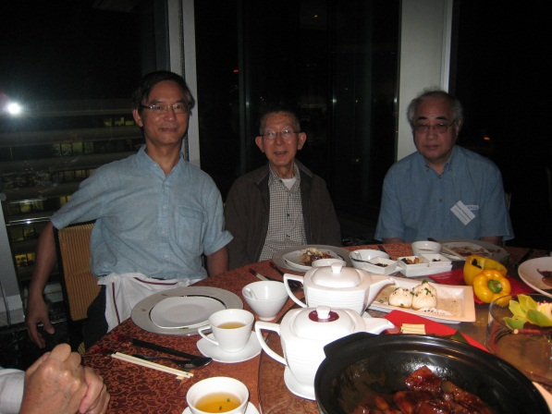
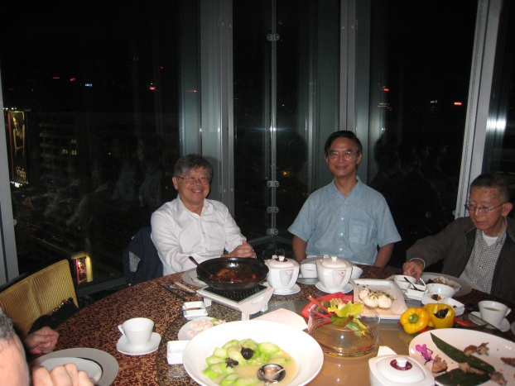
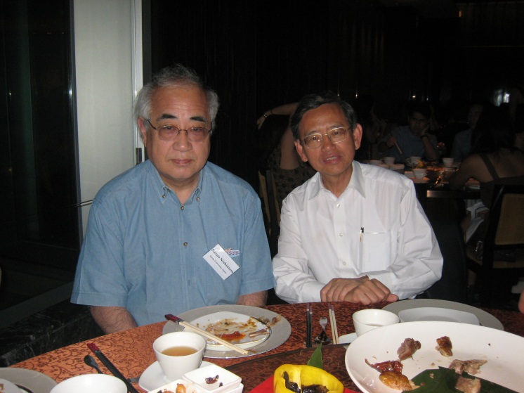
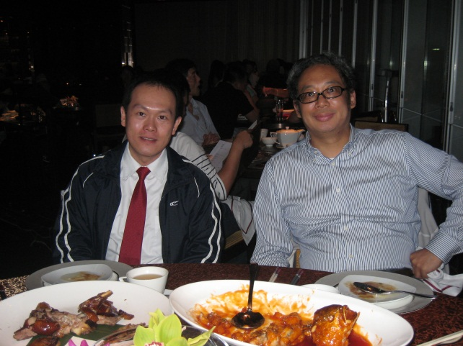
Dinner at a restaurant in Tsim Sha Tsui, Kowloon

