Slide 1
The 2012 APJAE Symposium on Advances in Studies of the Chinese Economy – Growth, FDI, Trade, Finance and Intellectual Property Rights
June 20-22, 2012
College Studio, College of Business,
City University of Hong Kong

Slide 2
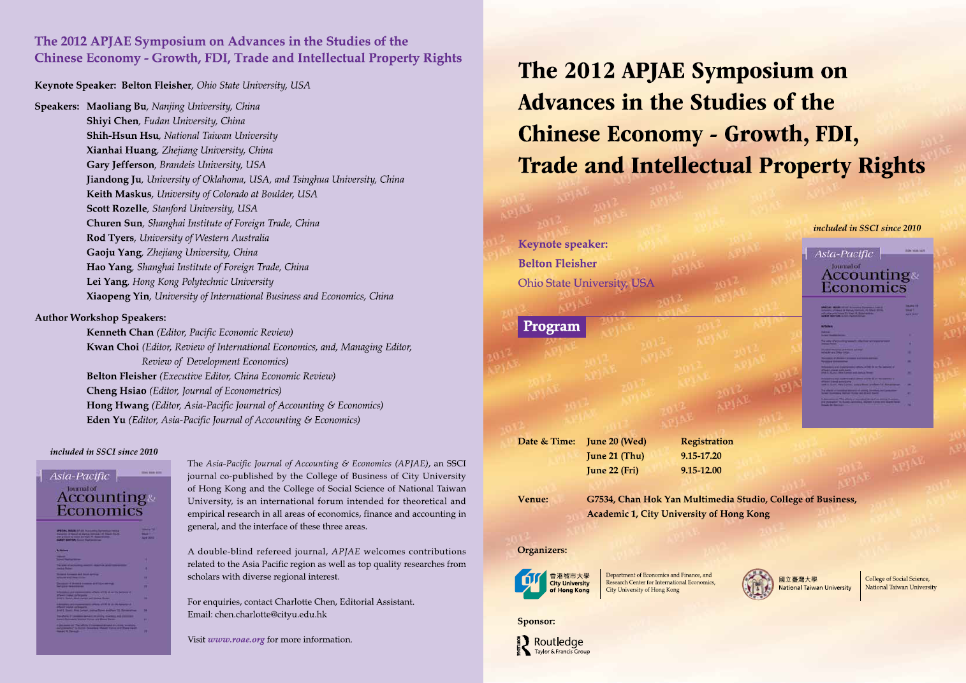
Program

Slide 3
Program

Slide 4
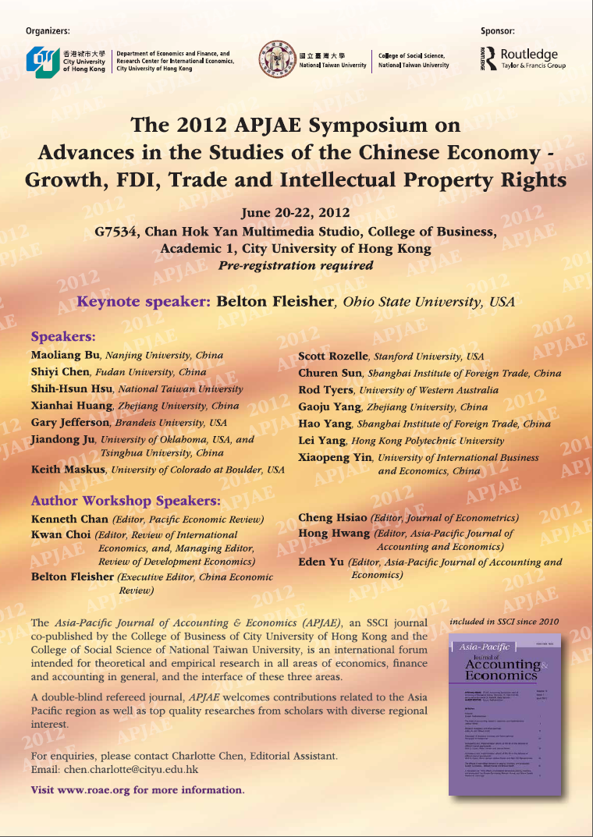
Poster

Slide 5
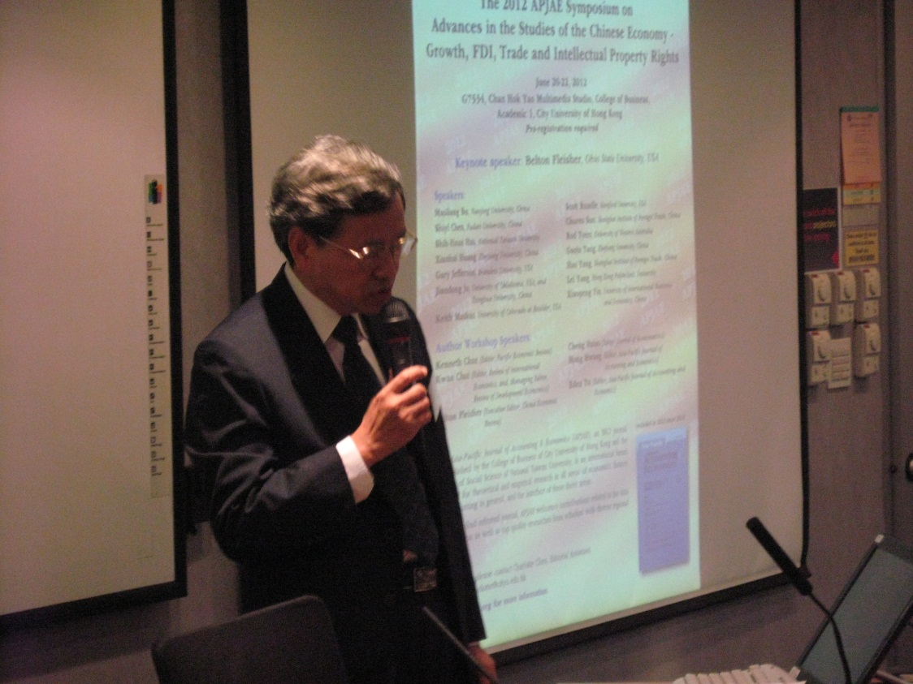
Welcoming remarks by Eden Yu of City University of Hong Kong, Editor of APJAE

Slide 6
Belton Fleisher of Ohio State University, USA presents the paper he co-wrote with W.H. McGuire, A.N. Smith and M. Zhou, “Patent Law, TRIPS, and Economic Growth: Evidence from China”.

Slide 7
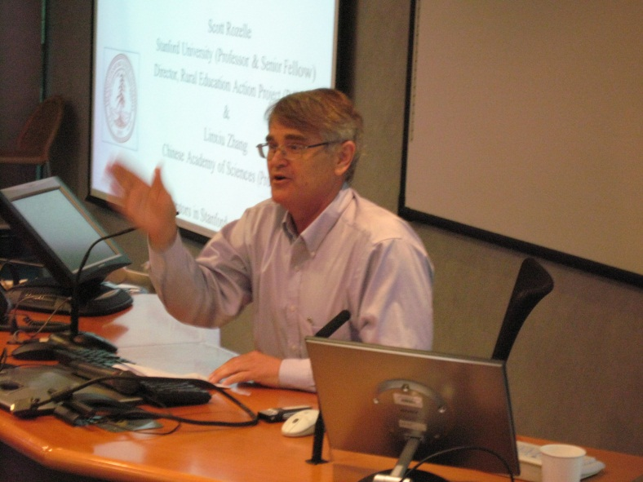
Scott Rozelle of Stanford University, USA presents the paper he co-wrote with K. Eggleston, J. Oi and X.G. Zhou, “Asia beyond the Headlines: Demographic Change and China’s Rise”.

Slide 8
Jiandong Ju of University of Oklahoma, USA and Tsinghua University, China presents the paper he co-wrote with S. Li, “Market Structure in The Chinese Steel Industry”.

Slide 9
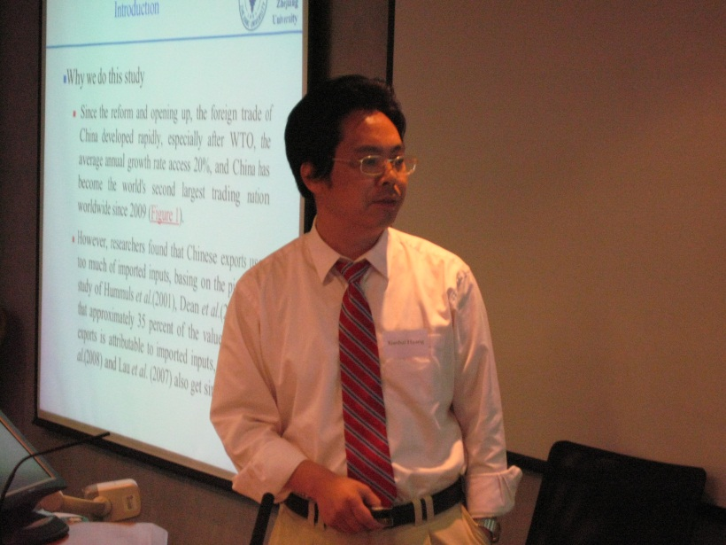
Xianhai Huang of Zhejiang University, China presents the paper he co-wrote with Gaoju Yang, “What is Used by the World Factory to Produce Exports: A Breakdown and Cross-country Comparison Based on a Non-Competitive Input-Output Model”.

Slide 10
Xiaopeng Yin of University of International Business And Economics, China presents his paper, “Two-way FDIs and International Product Cycles: The Case of Automobile Industry in China”.

Slide 11
Shiyi Chen of Fudan University, China presents the paper he co-write with S.J. Zhang, “Evaluate and Explain the Local Governance Performance in China: A Fiscal Perspective”.

Slide 12
Lei Yang of Hong Kong Polytechnic University presents the paper she co-wrote with S. Marjit and X.P. Xu, “Offshore Outsourcing, Contractual R&D and Intellectual Property in Developing Countries”.

Slide 13
Gary Jefferson of Brandeis University, USA presents his paper, “Does FDI Improve (or Crowd Out) the Export Performance of Domestic Firms? Evidence from Chinese Manufacturing”.

Slide 14
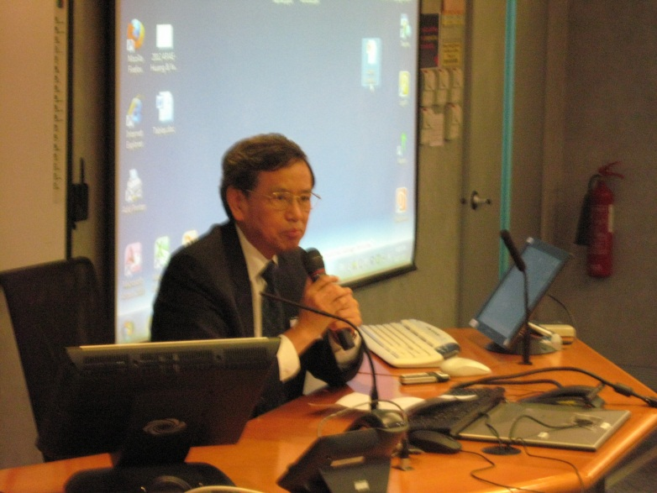
Author Workshop

Slide 15
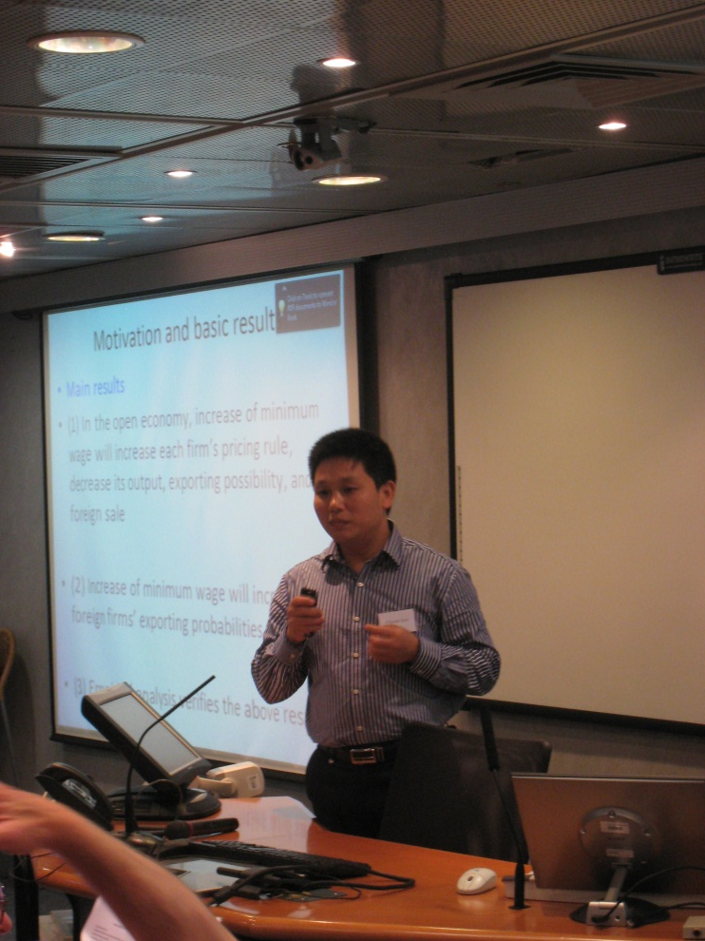
Churen Sun of Shanghai Institute of Foreign Trade, China presents the paper he co-wrote with S. Ma and G.Q. Tian, “Minimum Wage and Export: Evidence from Chinese Firm-level Data”.

Slide 16
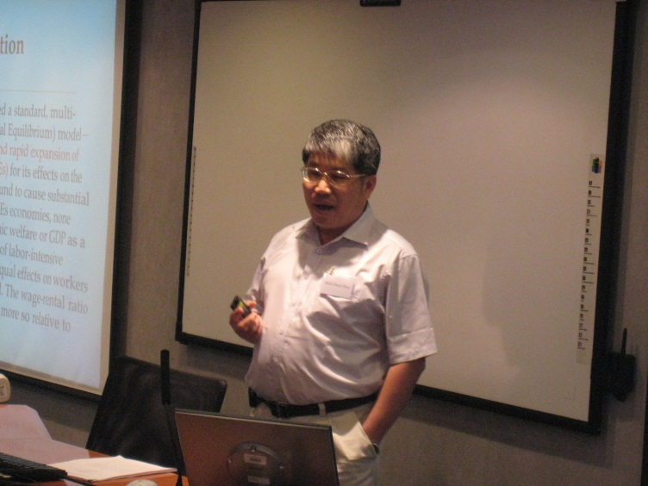
Shih-Hsun Hsu of National Taiwan University, presents the paper he co-wrote with C.C. Chang, K.J. Lin and S.M. Hsu, “The China Syndrome? The Impact of China’s Growth on Wage Inequality in East Asian Economies”.

Slide 17
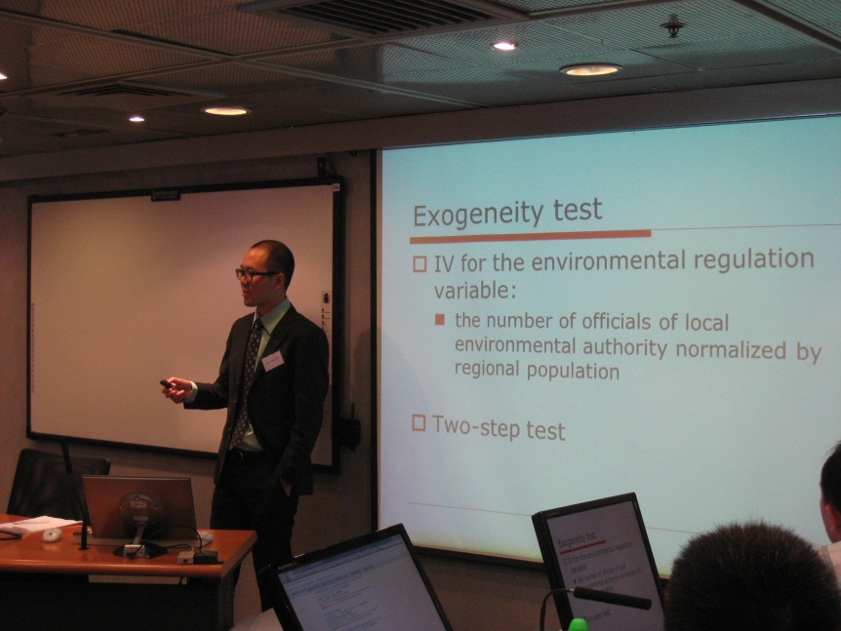
Maoliang Bu of Nanjing University, China presents the paper he co-wrote with Z.B. Liu and X.H. Yu, “Foreign Direct Investment, Corporate Social Responsibility and Pollution Haven Hypothesis in China”.

Slide 18
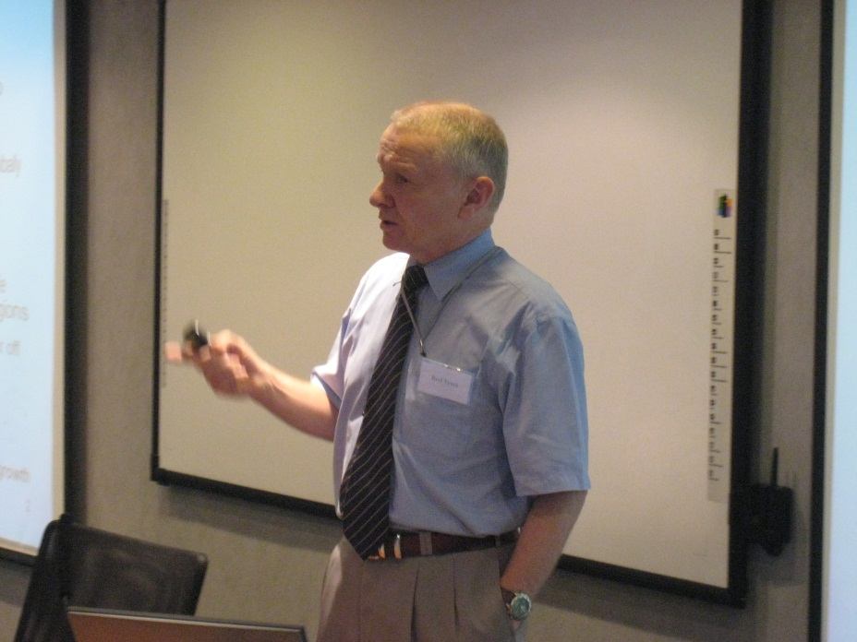
Rod Tyres of University of Western Australia presents his paper, “Looking Inward for Transformative Growth in China”.

Slide 19
Hao Yang of Shanghai Institute of Foreign Trade, China presents the paper he co-wrote with J.W. Liu and L.H. Lin, “The Study of China’s Impact on the Price of International Energy Product: the Case of Fuel Oil”.

Slide 20
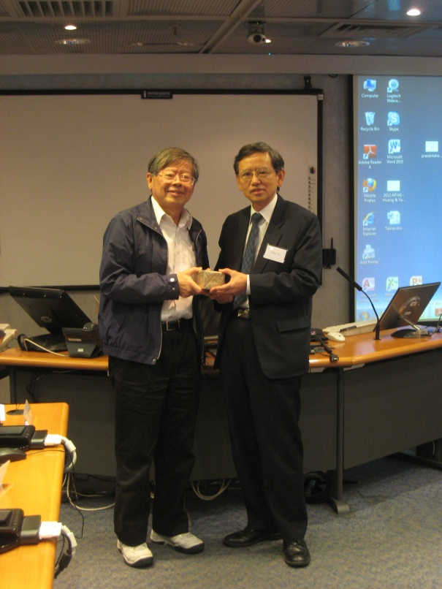
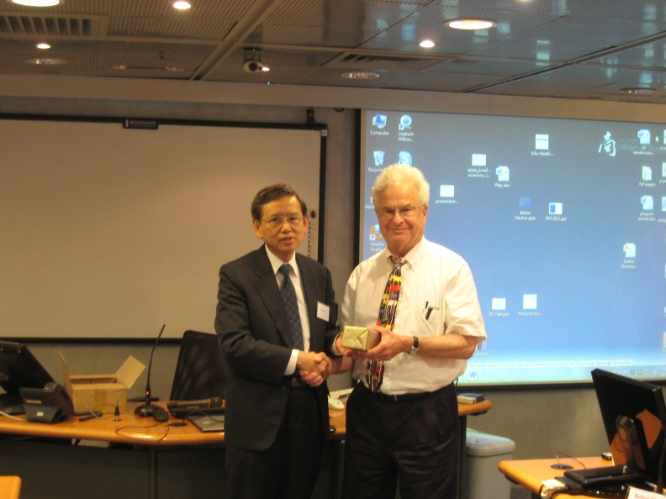
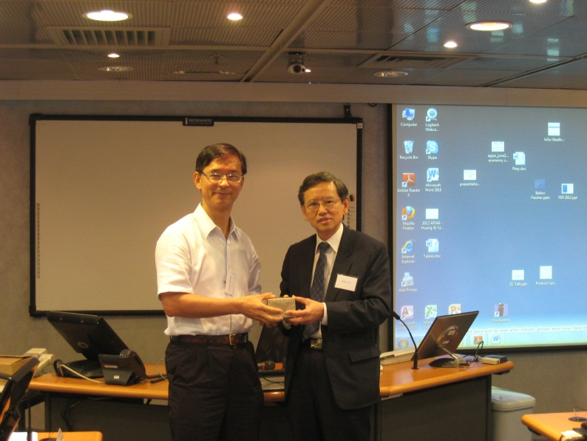
Souvenir presentation

Slide 21
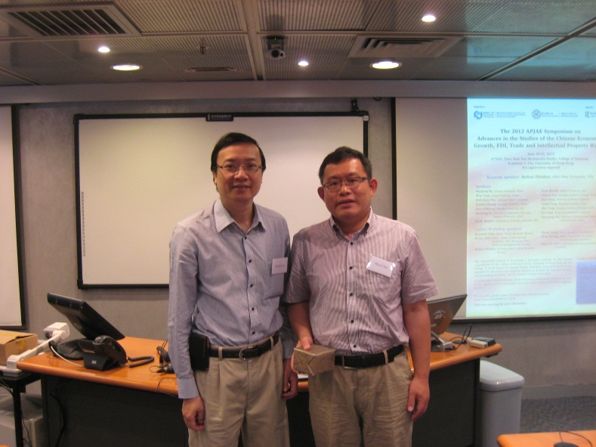
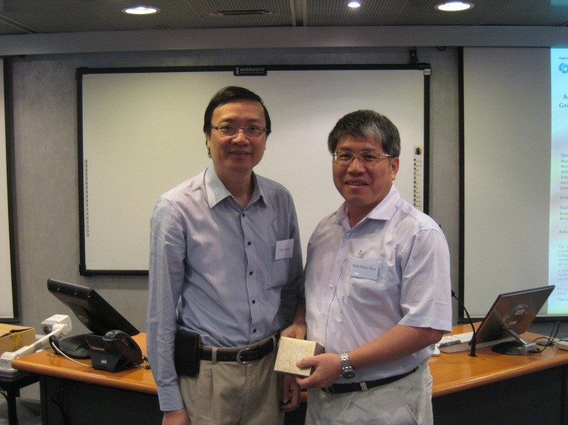
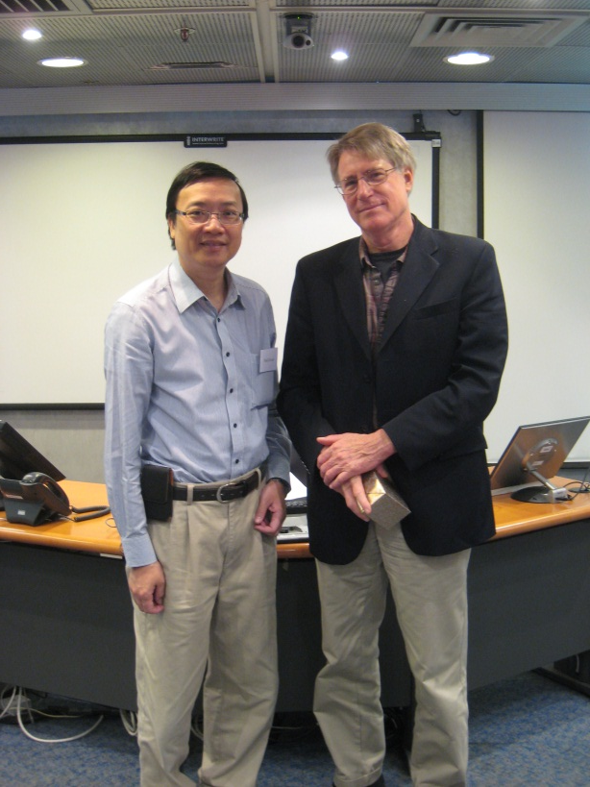
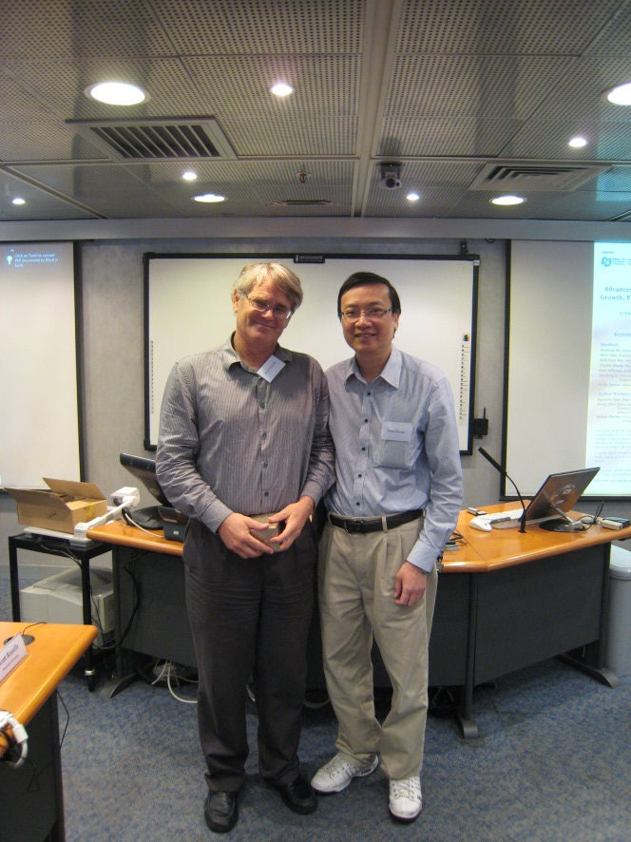
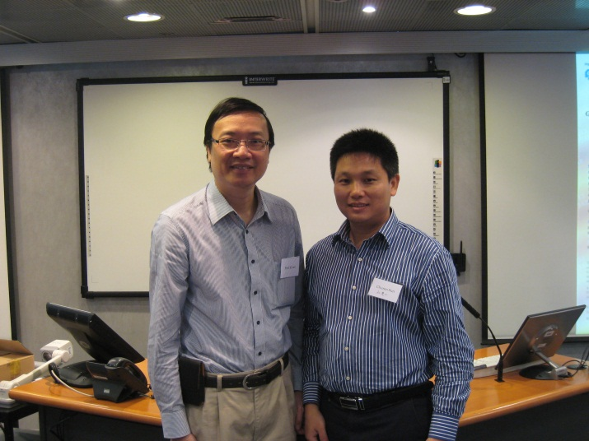
Souvenir presentation

Slide 22
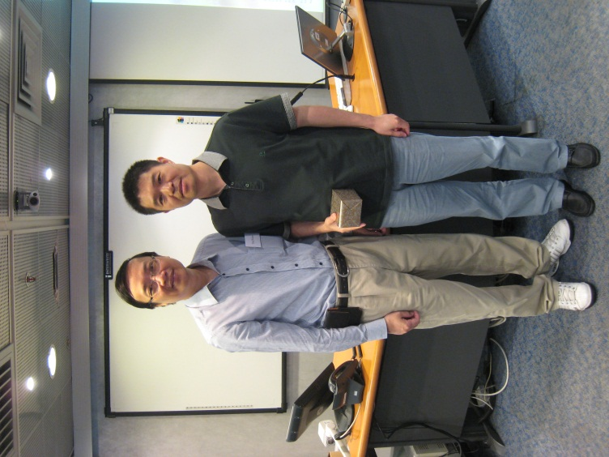
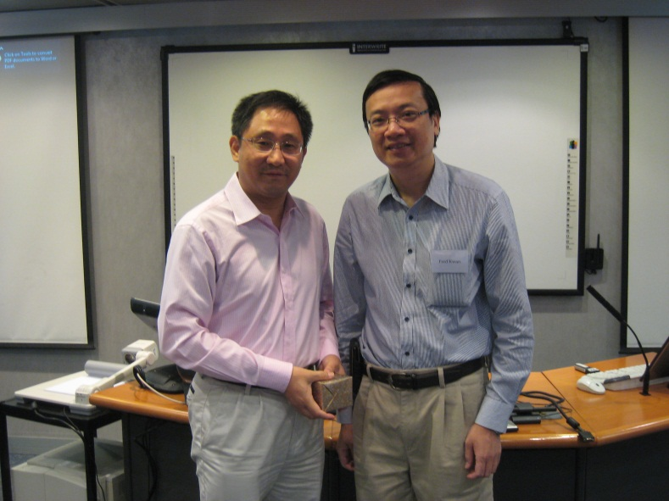
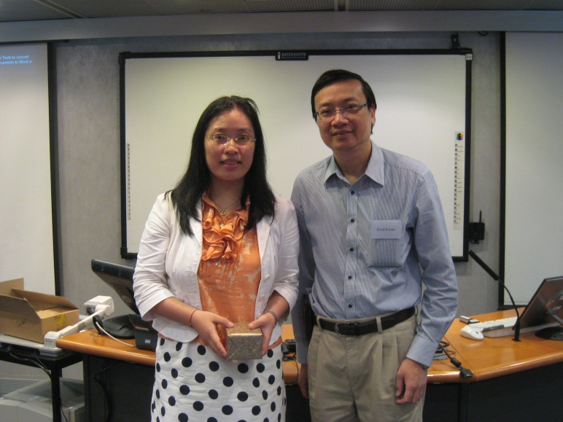
Souvenir presentation

Slide 23
Group picture

