Slide 1
The 2013 APJAE Symposium on Industrial Organization and Global Value Chains
June 19-20, 2013
College Studio, College of Business,
City University of Hong Kong

Slide 2
Program

Slide 3
Program

Slide 4
Poster

Slide 5
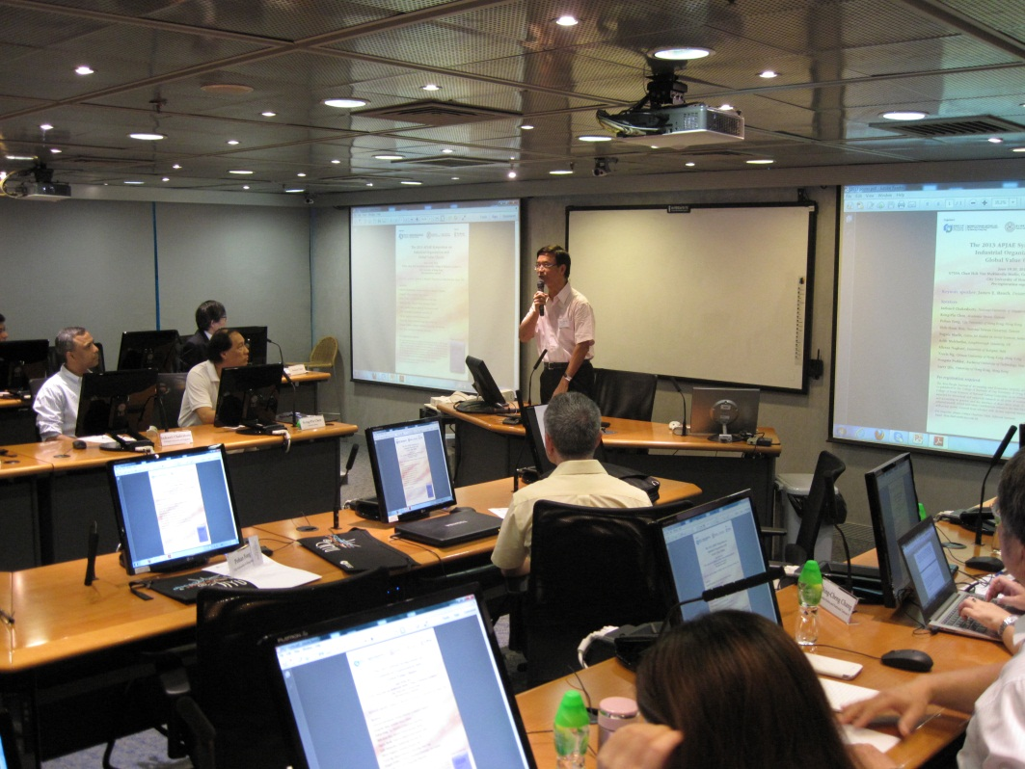
Welcoming Remark by Hong Hwang of National Taiwan University, Editor of APJAE

Slide 6
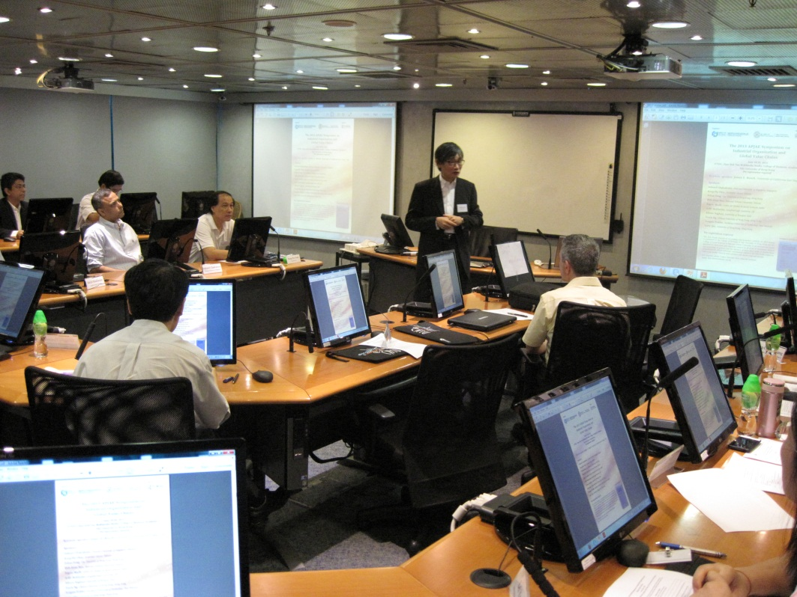
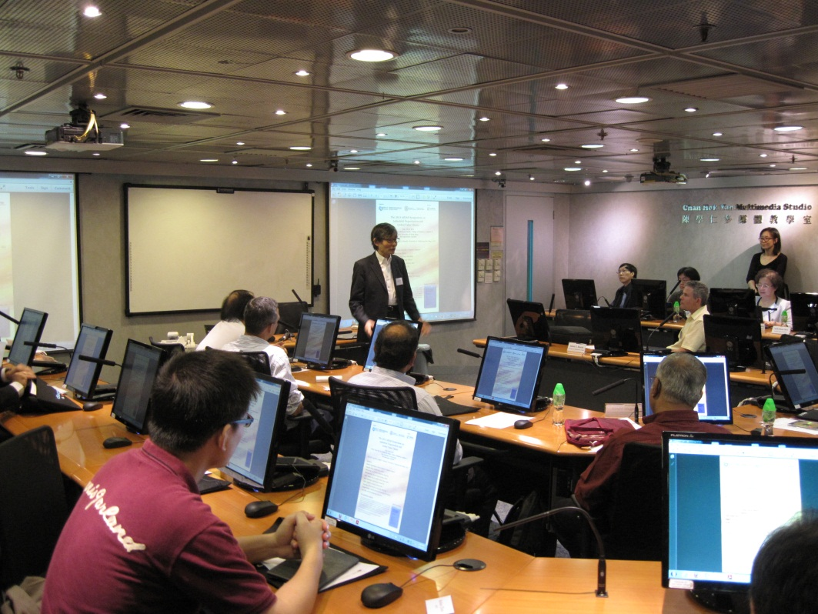
Welcoming Remark by Richard Ho of City University of Hong Kong, Secretary of APJAE

Slide 7
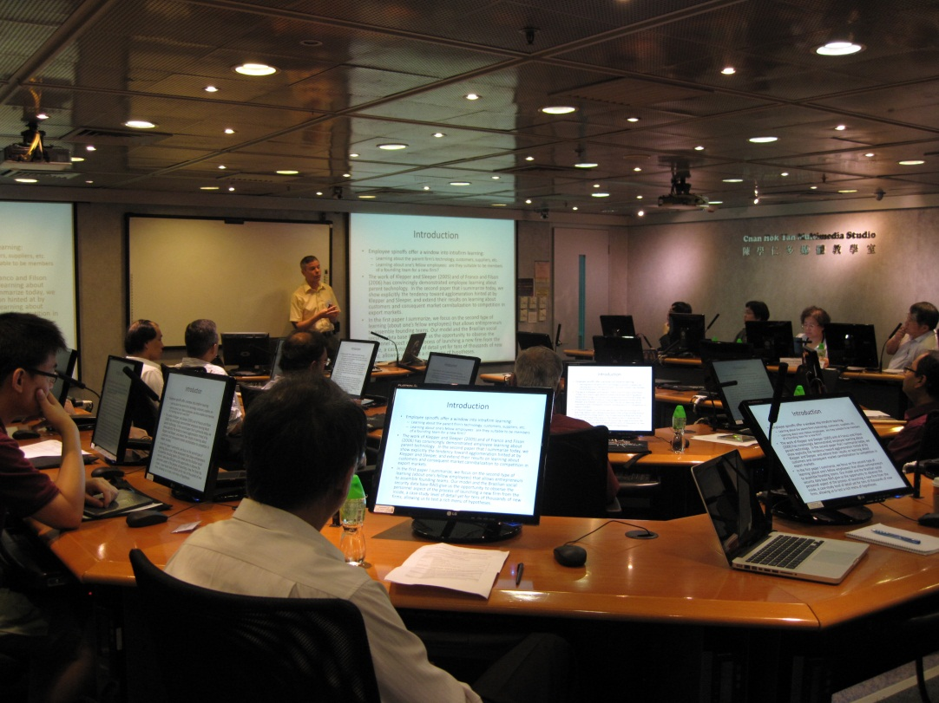
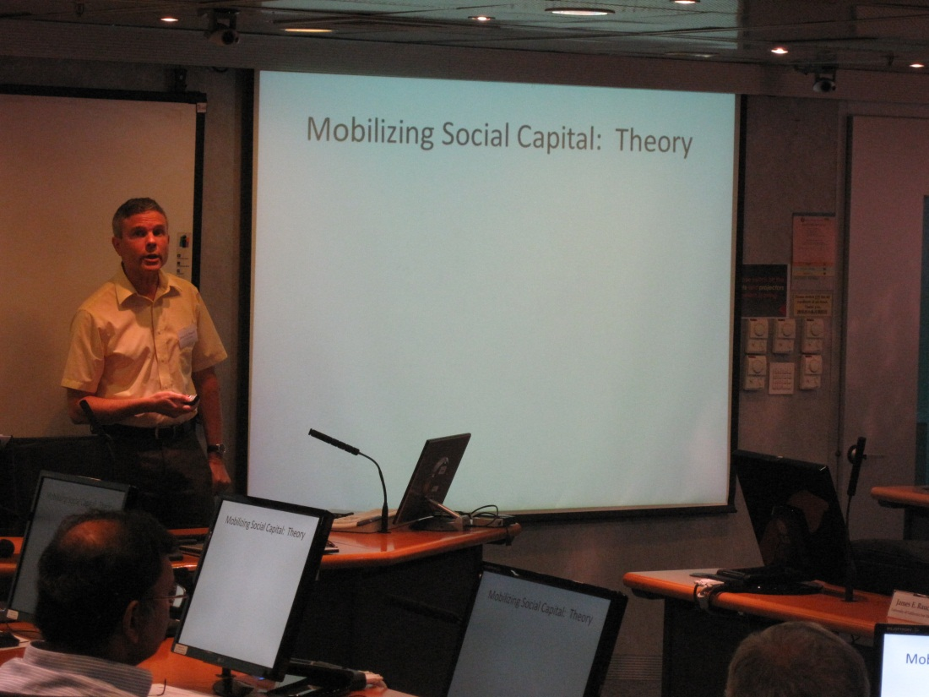
James Rauch of University of California San Diego, USA presents his paper “Employee Spinoffs: Mobilizing Social Capital and Contesting International Markets”.

Slide 8
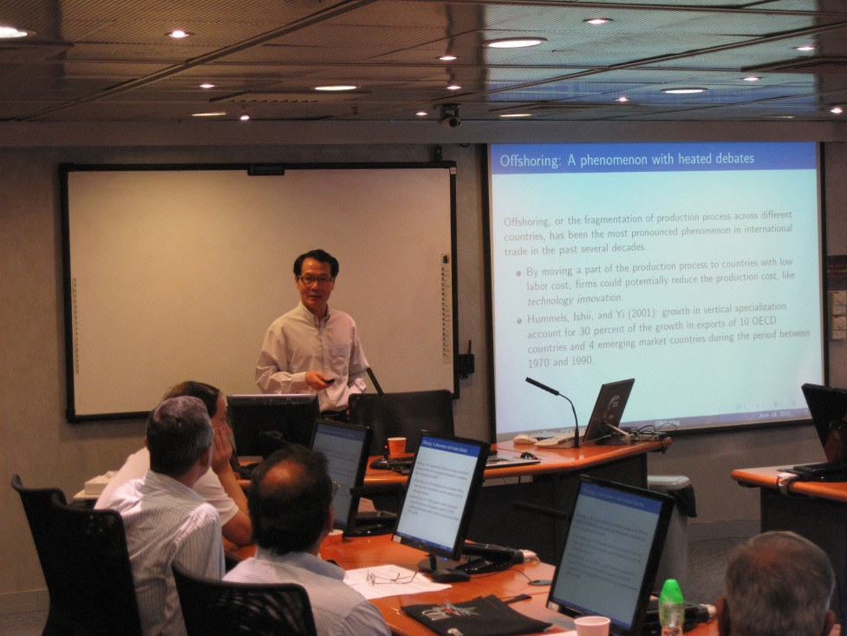
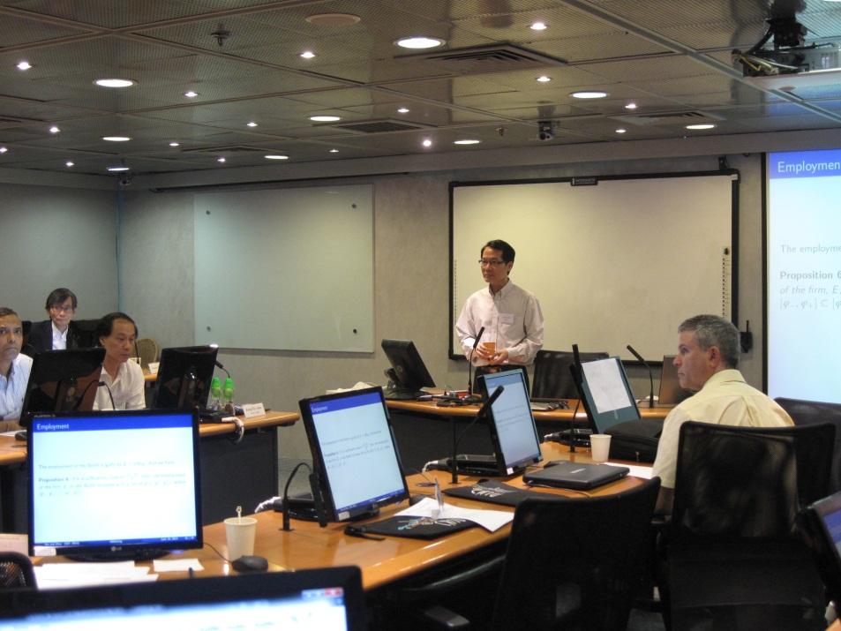
Larry Qiu of University of Hong Kong, HK presents the paper he co-wrote with Mohan Zhou, “R&D, Offshoring and Task Allocation along a Global Production Chain”.

Slide 9
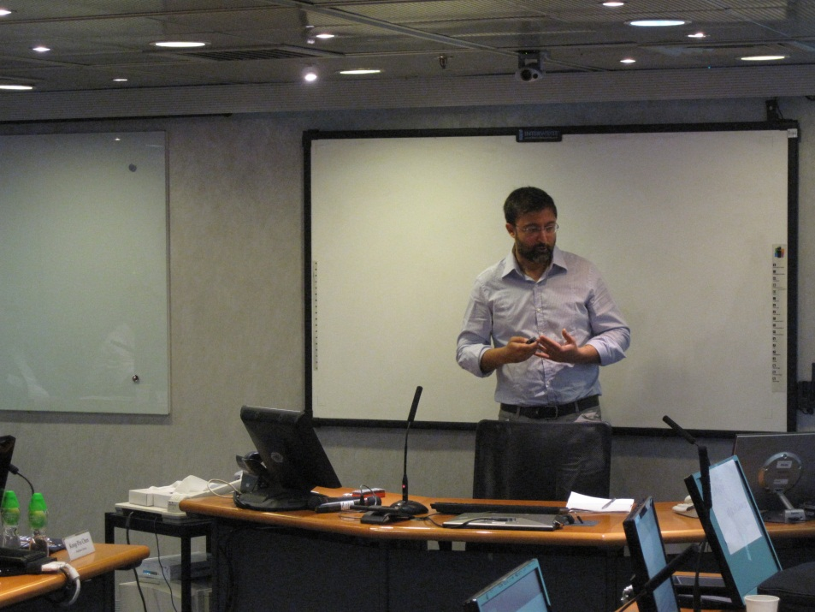
Alireza Naghavi of University of Bologna, Italy presents his paper “Outsourcing, Relationship-Specific Investments, and Supplier Heterogeneity”.

Slide 10
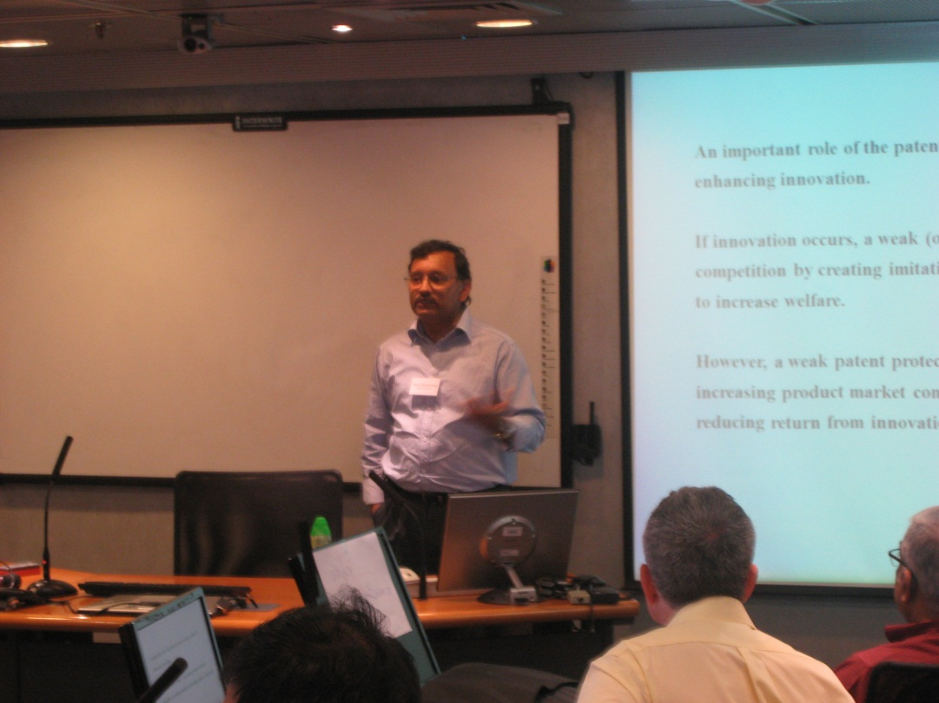
Arijit Mukherjee of Loughborough University, UK and CESifo, Germany presents his paper “Patent Protection and Endogenous Product Differentiation”.

Slide 11
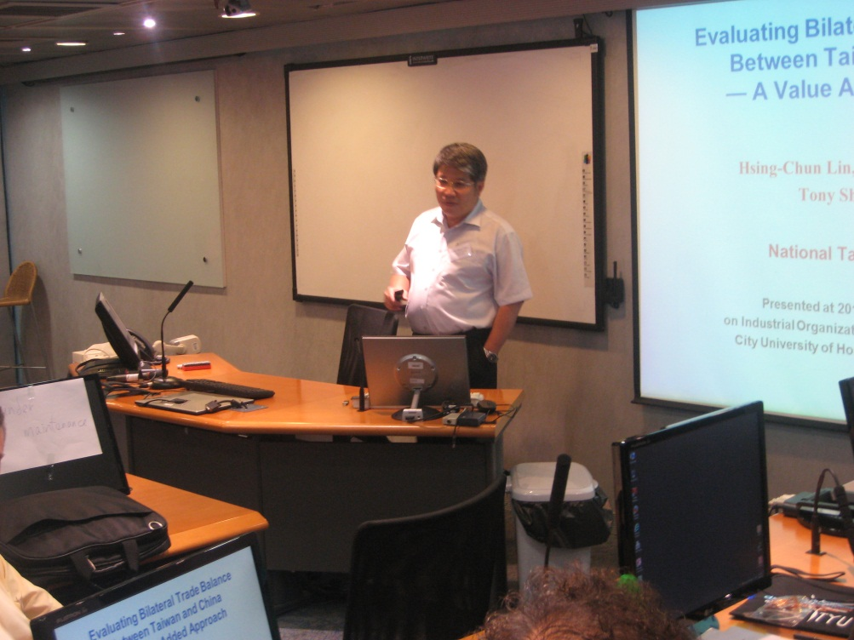
Shih-Hsun Hsu of National Taiwan University, Taiwan presents his paper “Evaluating Bilateral Trade Balance between Taiwan and China: A Value-Added Approach”.

Slide 12
Indranil Chakraborty of National University of Singapore, Singapore presents his paper “Truthful Bidding in Large Uniform-Price Auctions”.

Slide 13
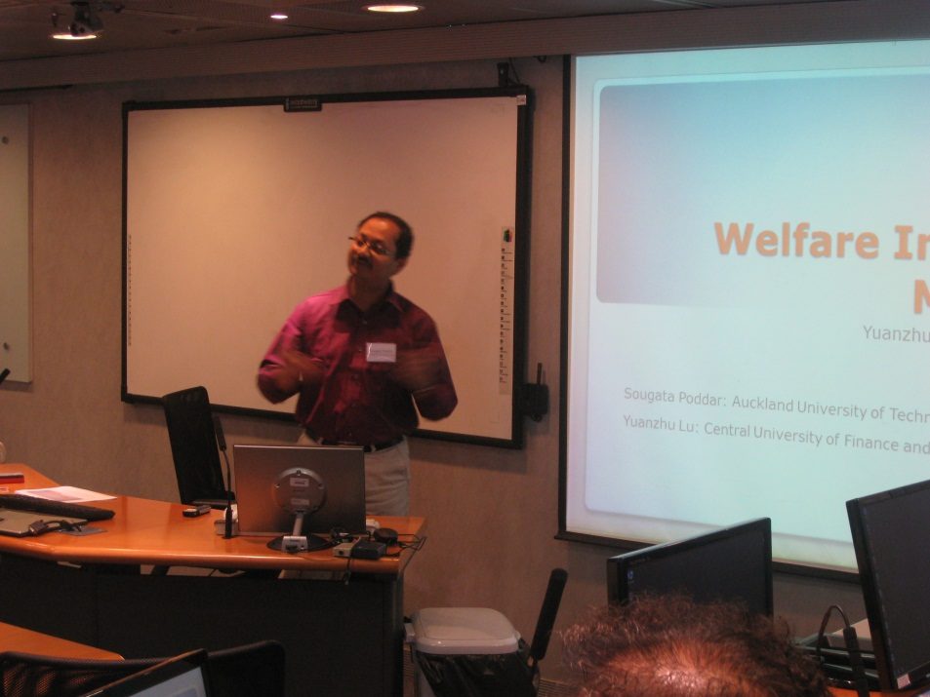
Sougata Poddar of Auckland University of Technology, New Zealand presents his paper “Welfare Improving Monopoly”.

Slide 14
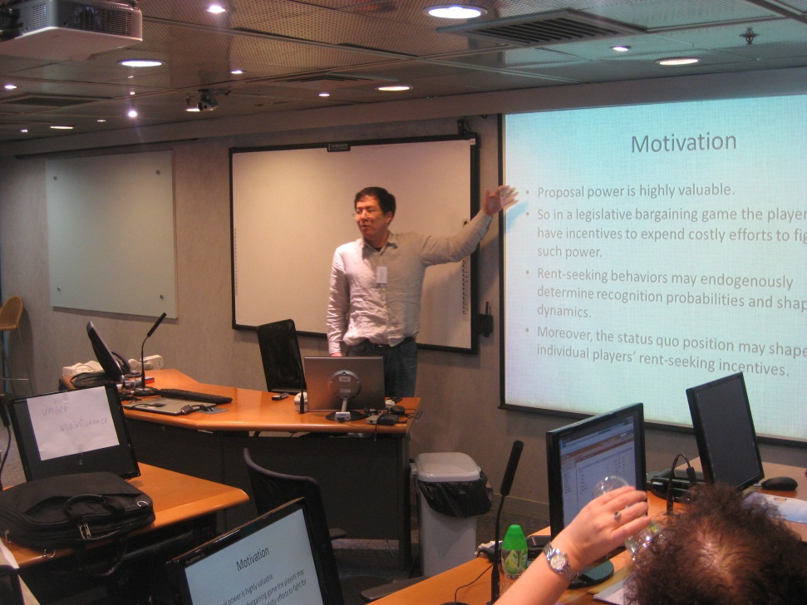
Pohan Fong of City University of Hong Kong, HK presents his paper “Dynamic Legislative Bargaining with Endogenous Proposers”.

Slide 15
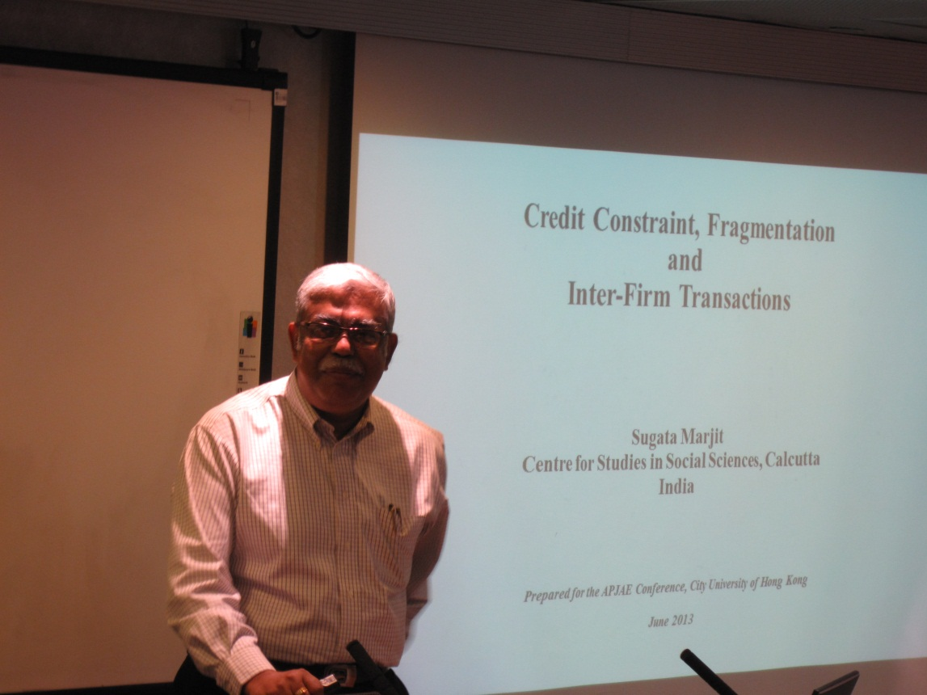
Sugata Marjit of Centre of Studies in Social Sciences, India presents his paper “ Credit Constraints, Fragmentation and Inter-Firm Transactions”.

Slide 16
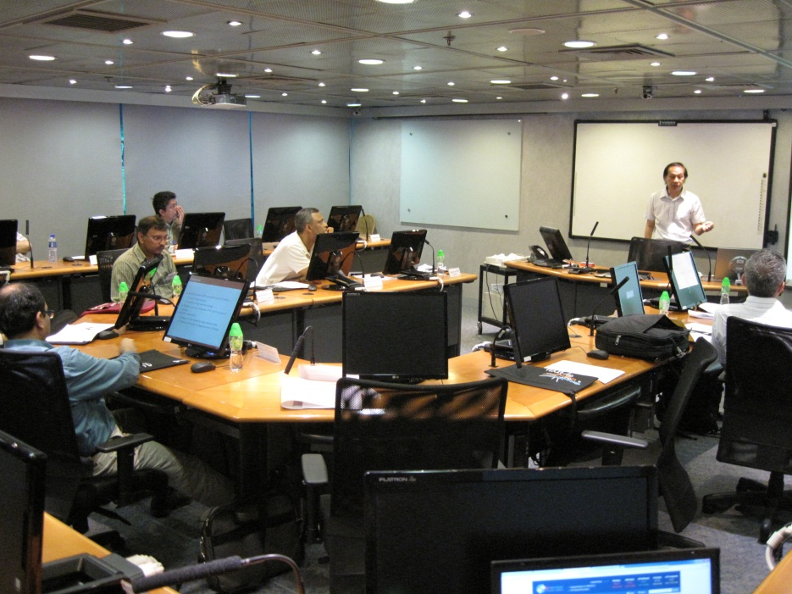
Kong-Pin Chen of Academia Sinica, Taiwan presents his paper “Do Consumers Discount Parallel Import Products”.

Slide 17
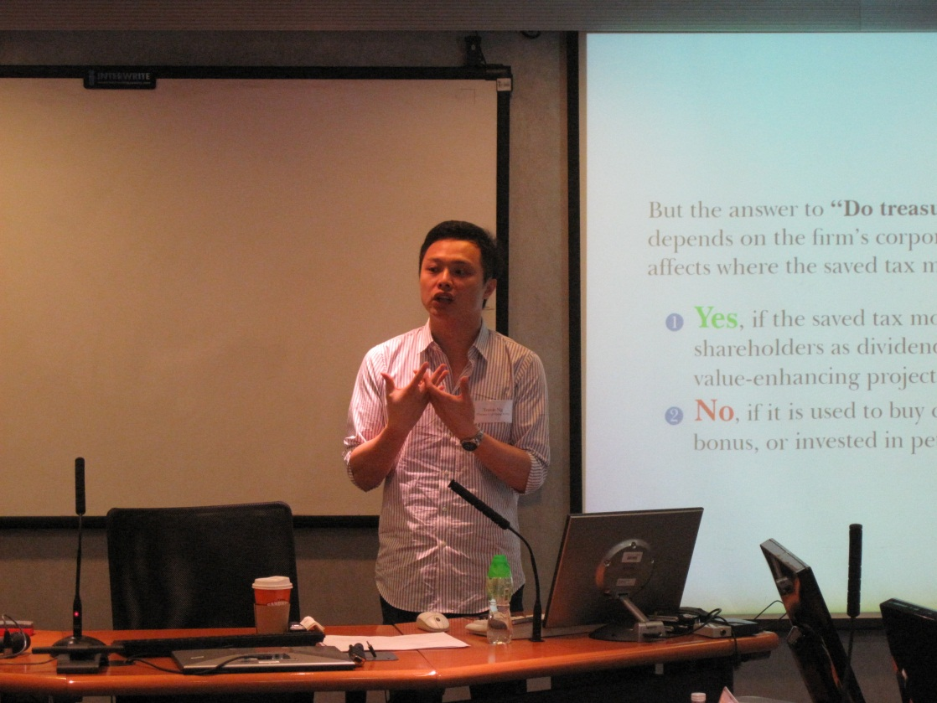
Travis Ng of Chinese University of Hong Kong, HK presents his paper “ Do Treasure Islands Create Firm Value”.

